Slide 1
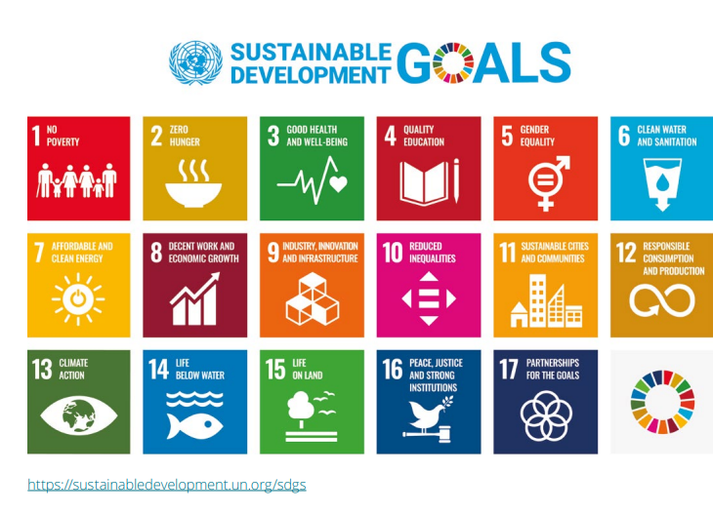
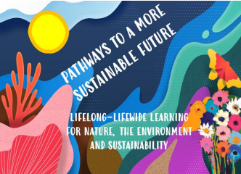
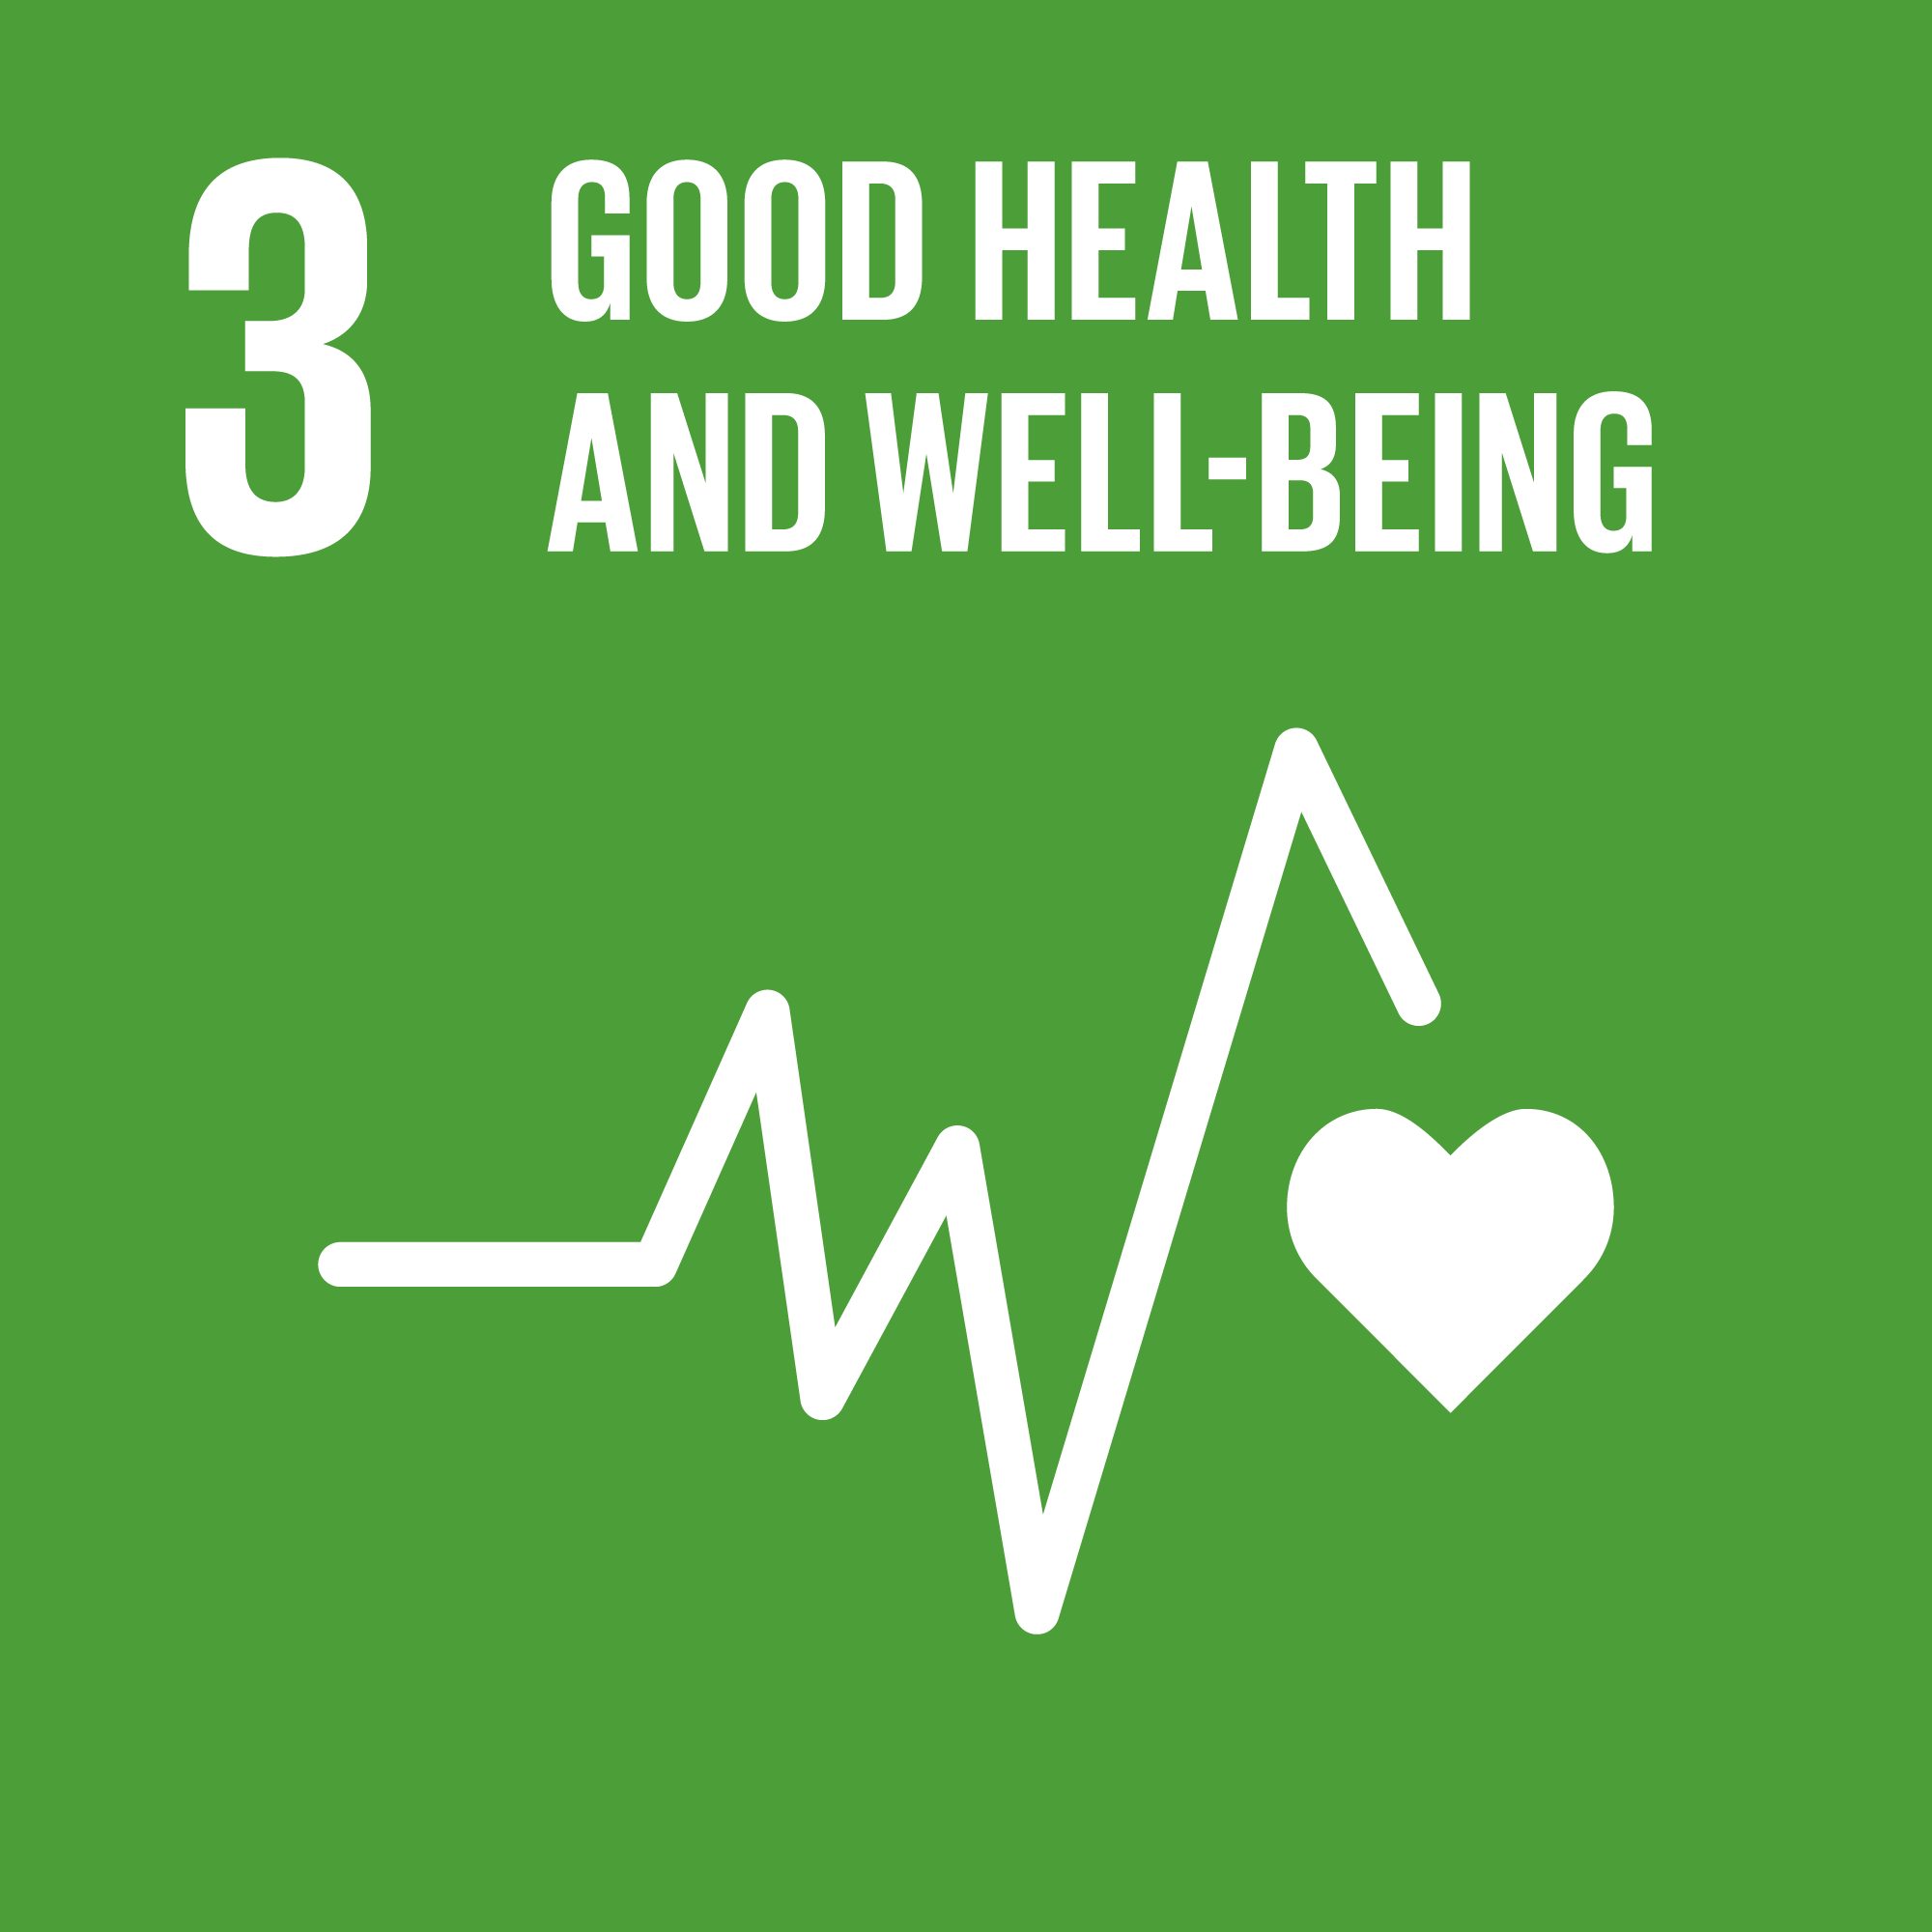

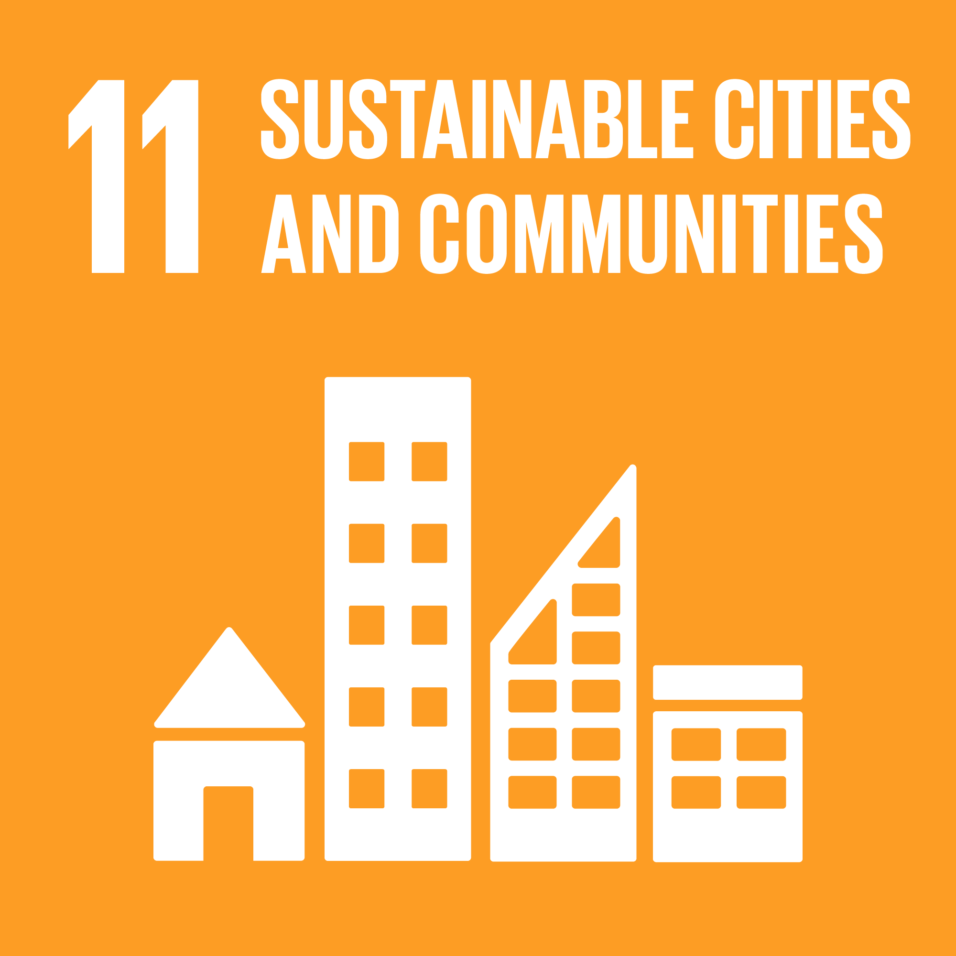

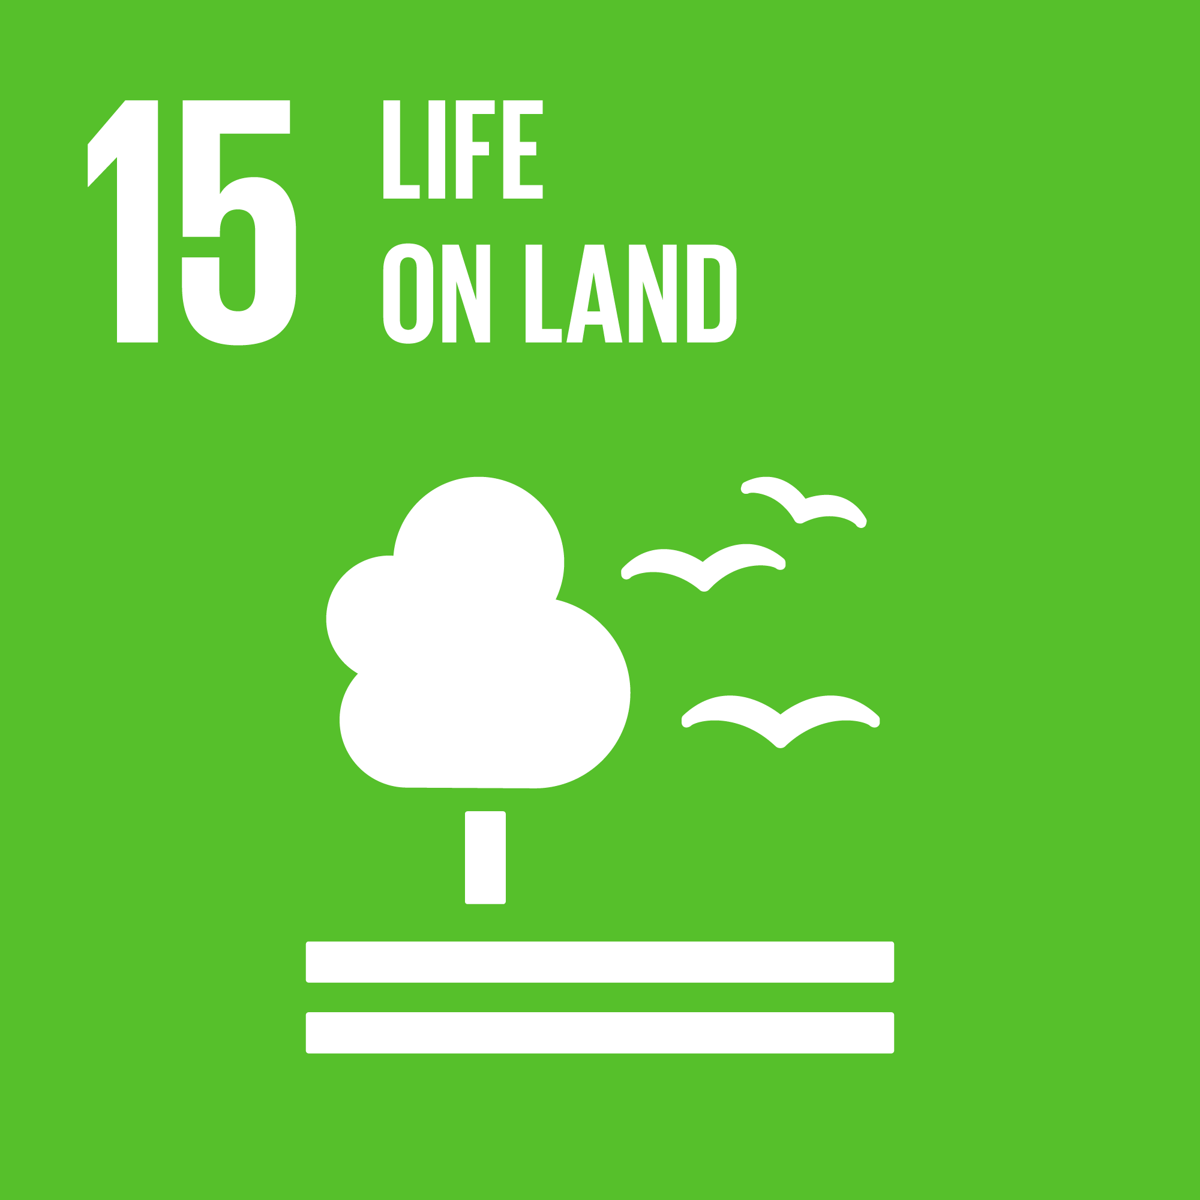

Final digital
presentation
Dory Reeves
Sep 2023
Length 4mins and 20 seconds with 3 slides
Notes:
Hi, My name is Dory Reeves. I am from Northern Ireland and live in Scotland. I have been involved in Life Wide Learning since 2015 and followed the Sustainable Development Goals (SDGs) since before 2016. I have been involved in a few of the LWL inquiries.
LWL is relevant at any age and stage of life. We learn through every aspect of our lives, as individuals, as neighbours, and community members as well as family members, employees, volunteers and so on. The list is endless.
Projects evolve, the great thing about this project was that there was an overarching goal – to see what we could do in the way we live to connect more with nature, the environment and sustainability and SDGs and enact the changes i.e. do something rather than simply write about it. And that was it. We could choose what we wanted.

Slide 2
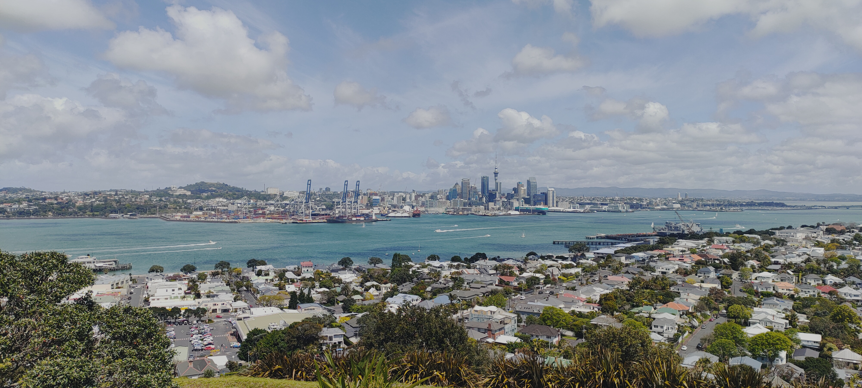
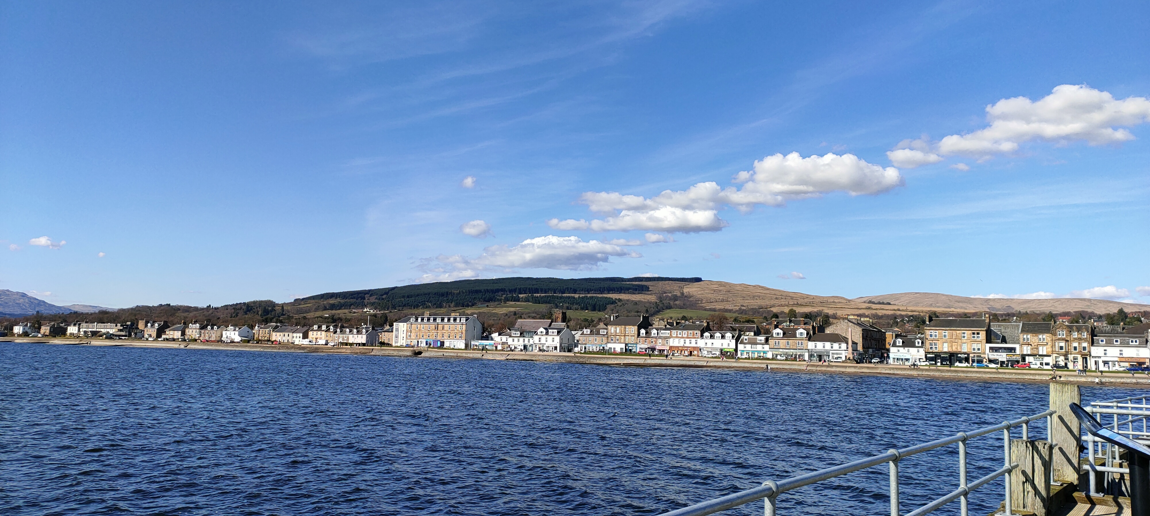
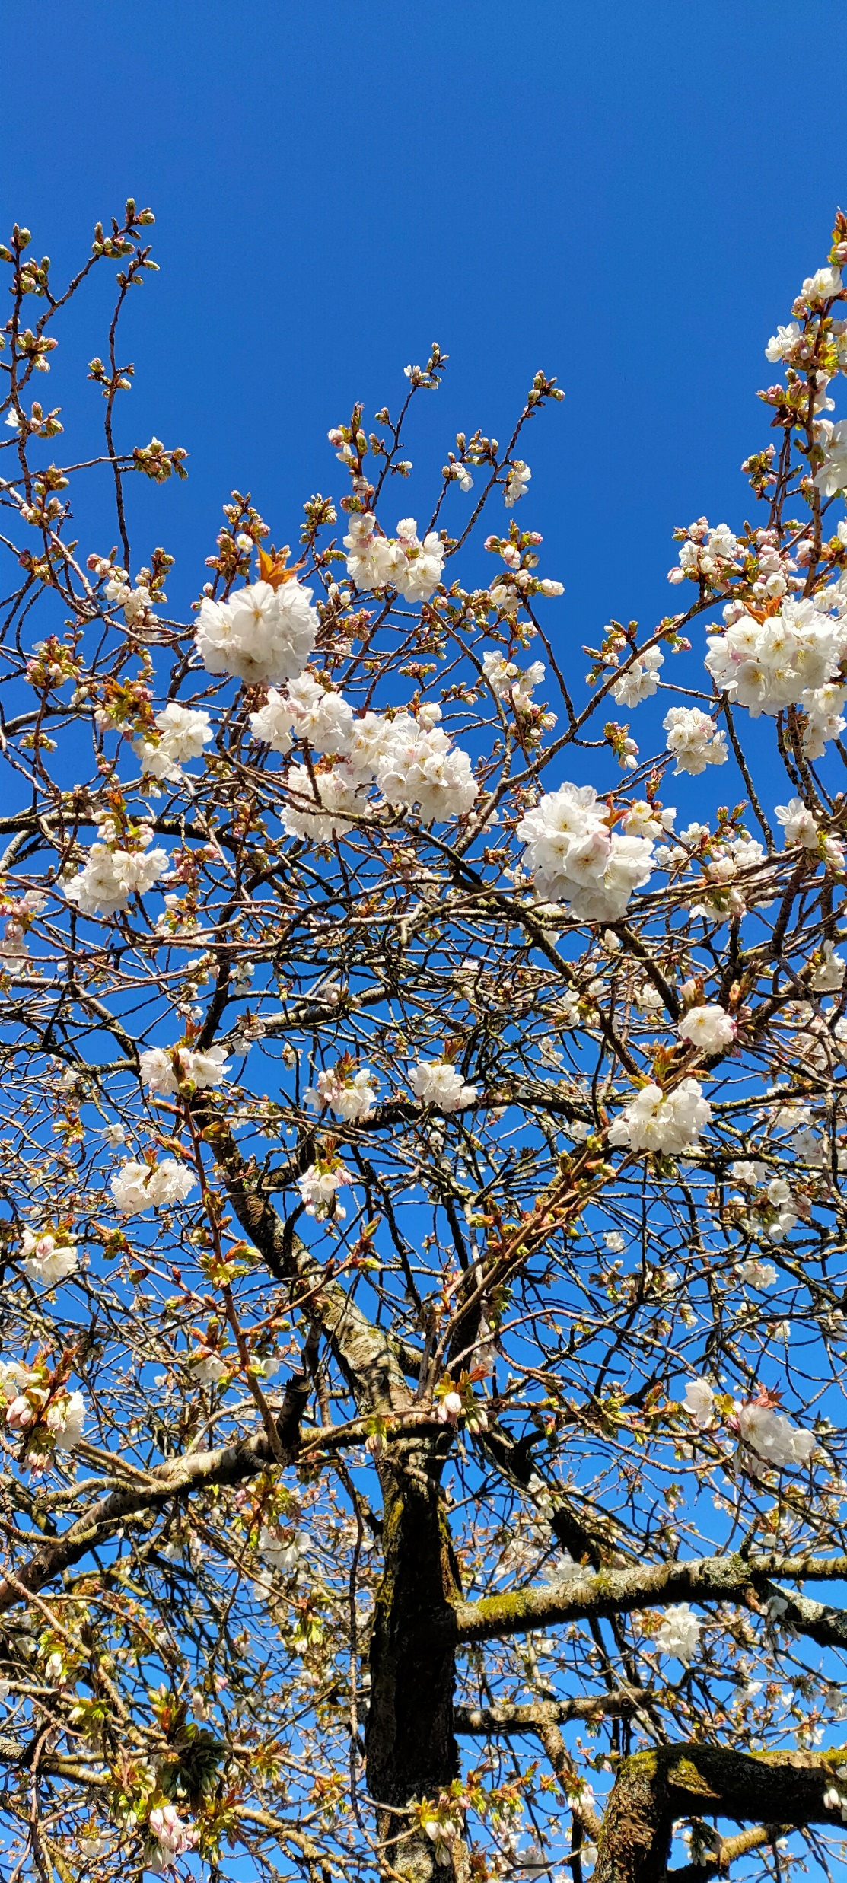
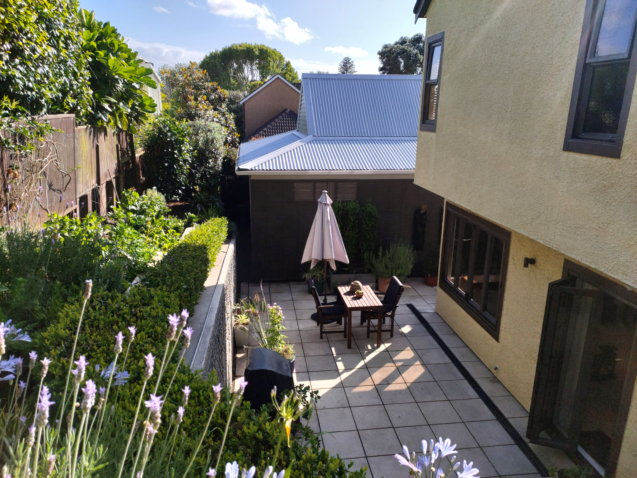
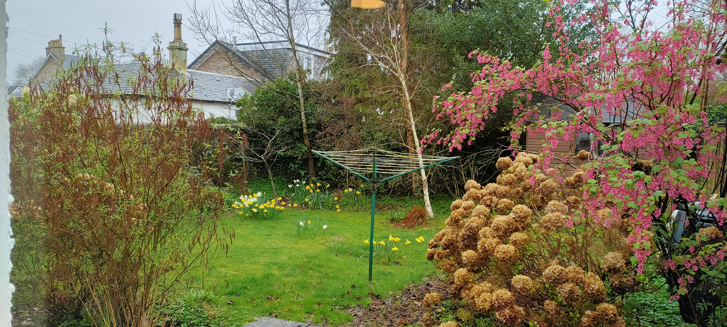
Pathways and significant moments
Tāmaki Makaurau, Aotearoa New Zealand
February-March 2023
Helensburgh, Garden City of the Clyde, Scotland
March 2023
Back yard garden
February 2023
Semi woodland garden
March 2023
Notes:
I have identified with 3 pathways on particular.
Physical pathway – readusting to a once familiar location following relocation. Reaquainting with town, community, neighbours.
Moved to a town house with a back yard garden returned to a small woodland garden
Emotional pathway – from the sadness of leaving Aotearoa, and friends there to the excitement and anticipation of the move.
Intellectual pathway – new place, different seasons, different nature and ecology
Here I identify with 3 moments or series of moments.
Being commissioned to do a short breifing note on National Park Cities which got me wondering whether and how this idea would translate to a garden.
That moment early on when I wondered whether I could commit to a 6 month inquiry was simply to go for it; treat it as fun, a chance to engage withe people world wide and devote what time I felt I could
The online sessions where every time I came away with a gem I could apply; whether it was a reminder to engage all the senses to enjoy nature from different angles and perspectives

Slide 3
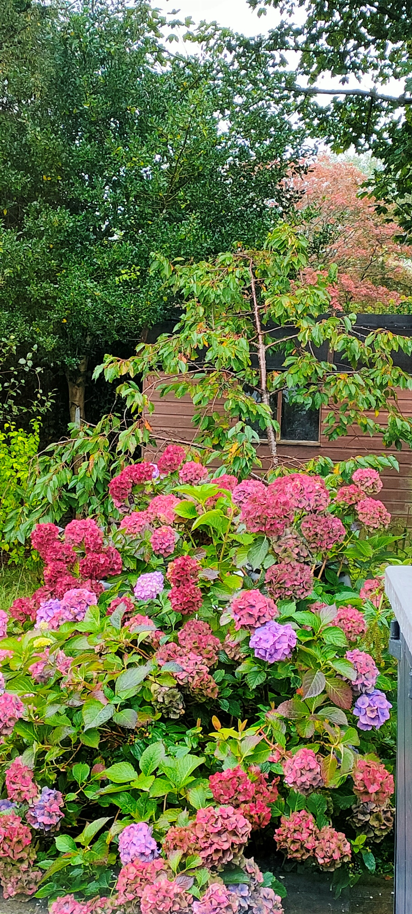
Changes and learning
Notes:
Learning occurs at different levels.
From March to October we have gone from Spring to Autumn in the northern hemisphere, I have moved from NZ to Scotland and feel like I have been relearning how to live in the UK.
As far as this project is concerned though - at a very basic level: 6 months ago I didn’t know what a nurdle was, what impact they have on nature and how to identify them on a beach clean. 6 months ago I didn’t know what a national park city is and how they can contribute to greening our cities; 6 months ago I didn’t know how to create a pond from a sink or a raised bed from an old bath. 6 months ago I didn’t know how much plastic free Helensburgh was doing; I didn’t know what a beeline is and how to create one; and I didn’t know how the Take 1 Programme is raising awareness of the SDGs in schools through projects like creating a meter of meadow.
At a deeper level say mid level - the project and everything connected to it in the LWL web has helped to change how I see things. I am more relaxed, fitter, healthier, connected and settled. Transformed is probably too strong a word.
My pathway to a more sustainable future is modest - to continue to become more aware and to apply what I am learning and to share with others.

