Slide 1
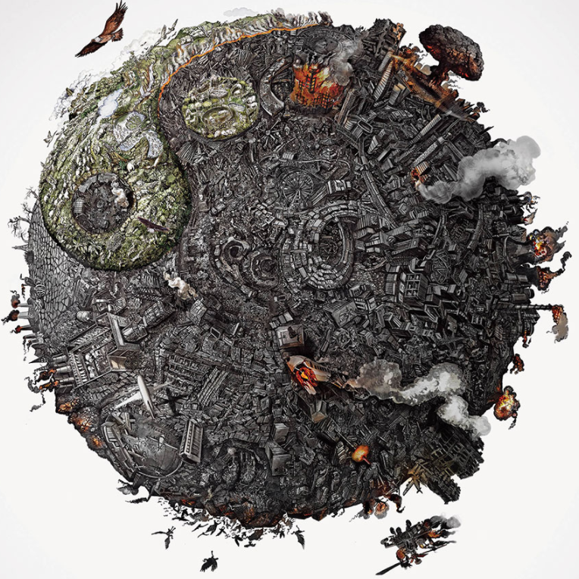
The great work
now, as we move into
the new millennium, is
to carry out the
transition from a period
of human devastation of
the Earth to a period
when humans would be
present to the planet in
a mutually beneficial way
Thomas Berry
‘The Great Work’

Slide 2
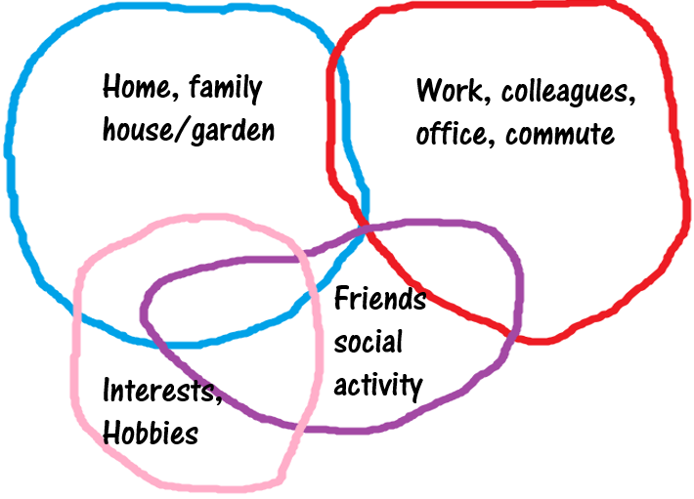
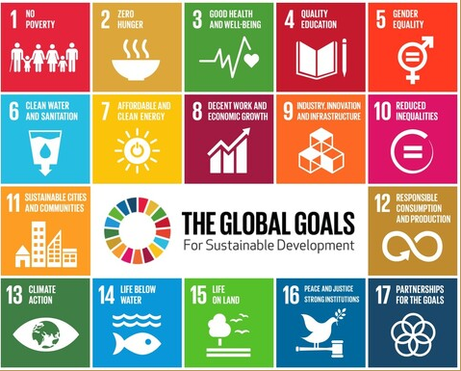
PERSONALISING sdg-related interactions
SELF
deliberate action
knowledge/awareness
ENVIRONMENT
17 SDGs/GLGs

Slide 3
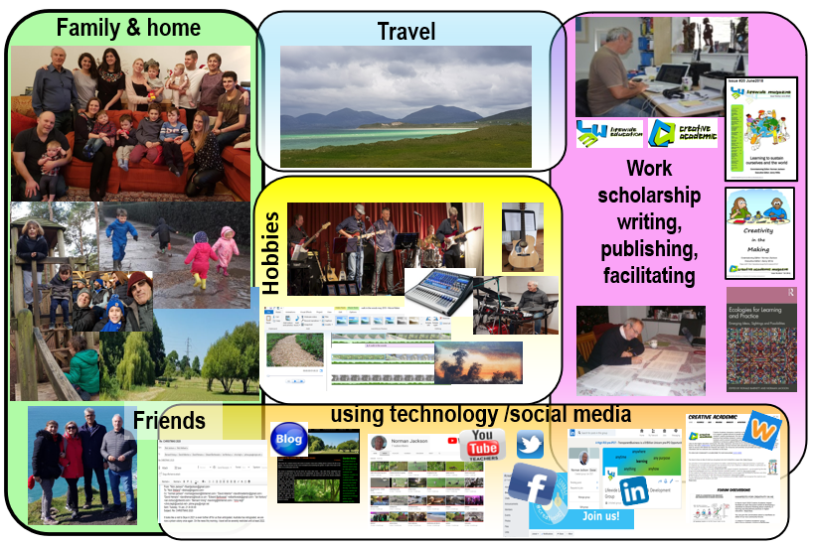
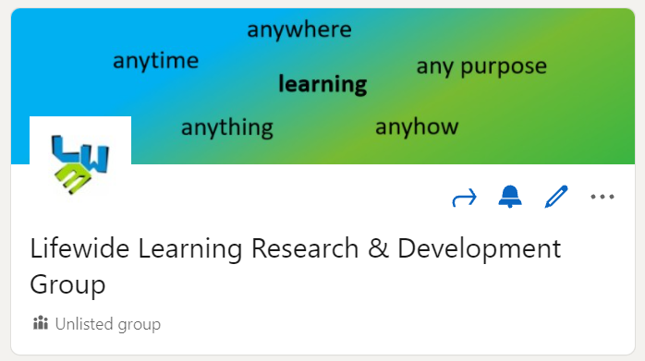
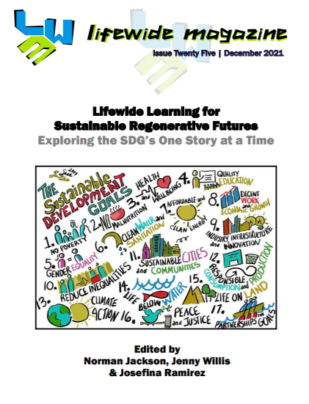
Working with the SD goals – one story at time
Many
Stories
My Story
ANALYSIS
SYNTHESIS
Share, read,
discuss &learn
CURATE & SHARE

Slide 4
KNOWLEDGE DEVELOPMENT
Symbolic
written
knowledge
EXPLICIT
codified
Analysis &
synthesis
creating meaning
Reading, discussion
& reflection
uncodified
TACIT
SDG statements
& vignettes/reflection
Embodied knowledge
enacted experience
concrete
abstract
Diagram adapted from Max Boisot (1998)

Slide 5
contributions
WEEK 1 21 personal SDG statements
WEEK 2 12 written + 2 video vignettes
WEEK 3 13 written vignettes
WEEK 4 11 written + 1 video vignette
WEEK 5 08 reflective commentaries
65 SDG statements/vignettes/commentaries
360+ comments in discussion

Slide 6
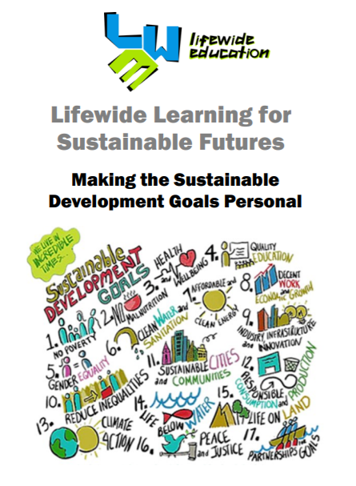
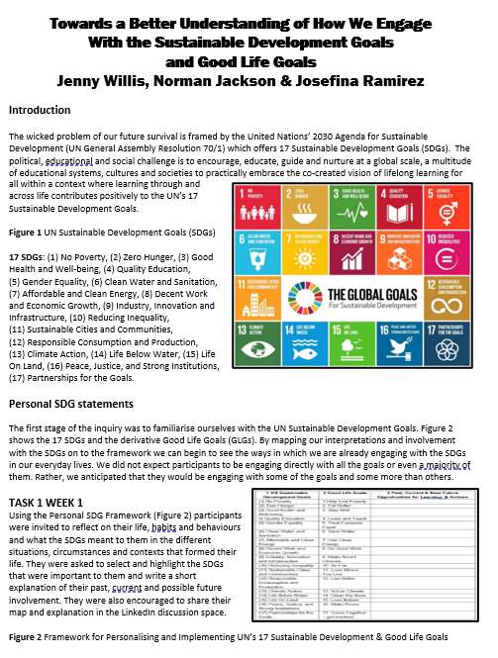
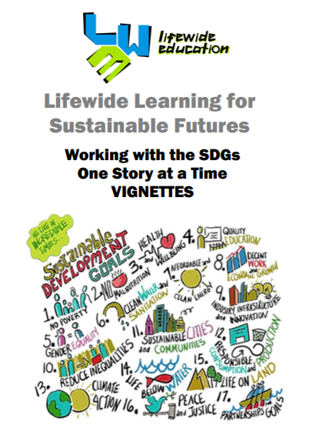
CONTRIBUTION, COMPILATION, ANALYSIS & SYNTHESIS
Jenny Willis
to present short
summary
SDG STATEMENTS
To be analysed
+
Final reflections,
& contributions today
WHAT HAVE
WE LEARNT?
VIGNETTES

Slide 7
THE WISDOM OF OUR COLLECTIVE
Learning about sustainability and the SDGs
Learning about Ourselves
Future practice & behaviour
Challenges to living a life that is more sustainable
Inquiry as self-organised adult education
Things we might do to progress understanding & practice?

Slide 8
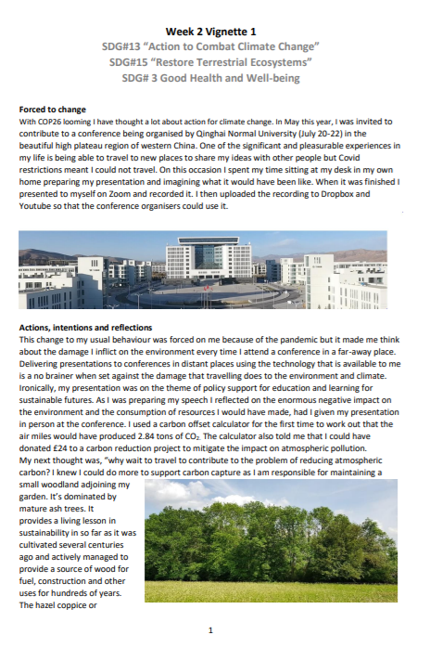
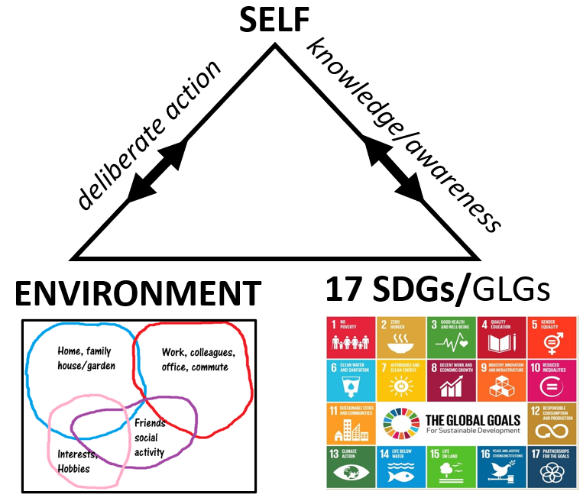
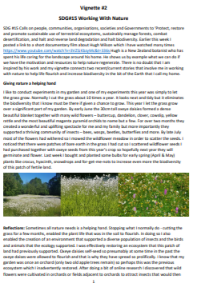
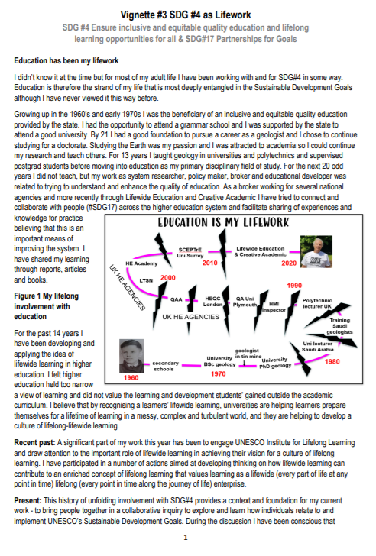
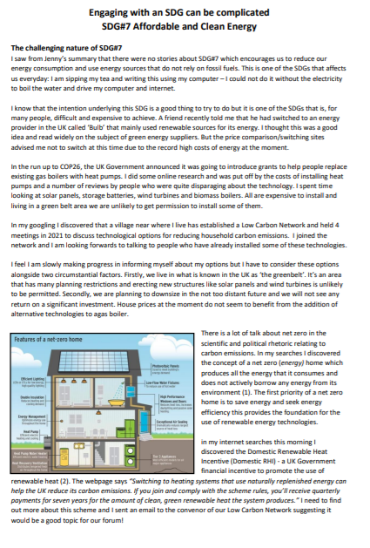
My 4 vignettes
SDG 13, 15 & 3
SDG 15
SDG 3
SDG 7
Can we demonstrate that the
whole of life is implicated in
our engagement with the SDGs?

Slide 9
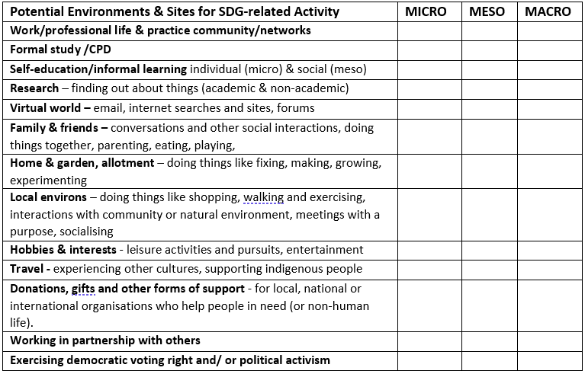
Mapping the Lifewide dimension of SDG-related activity

Slide 10
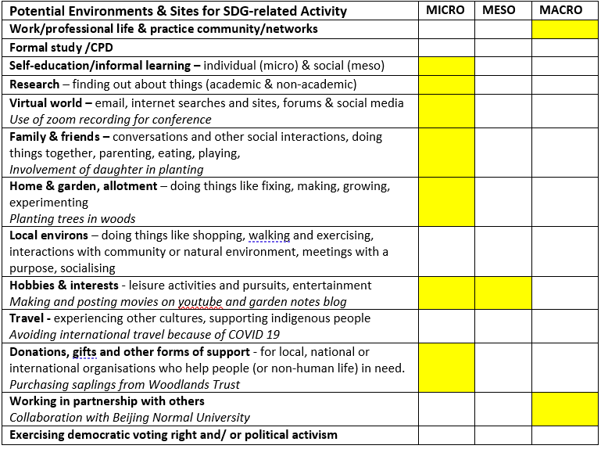
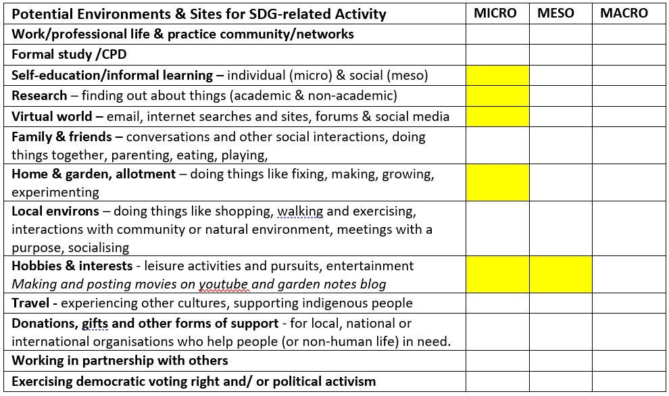
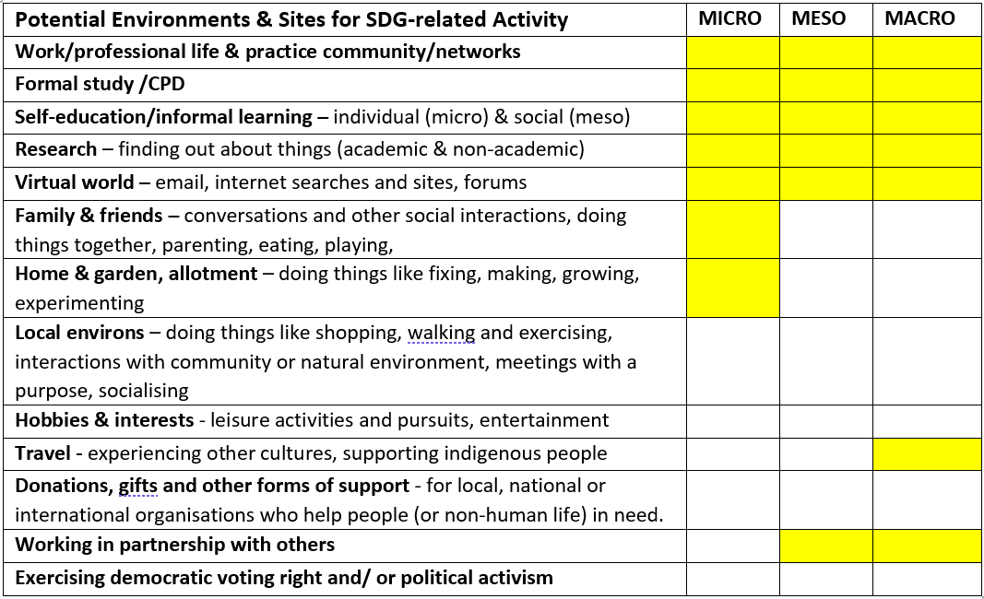
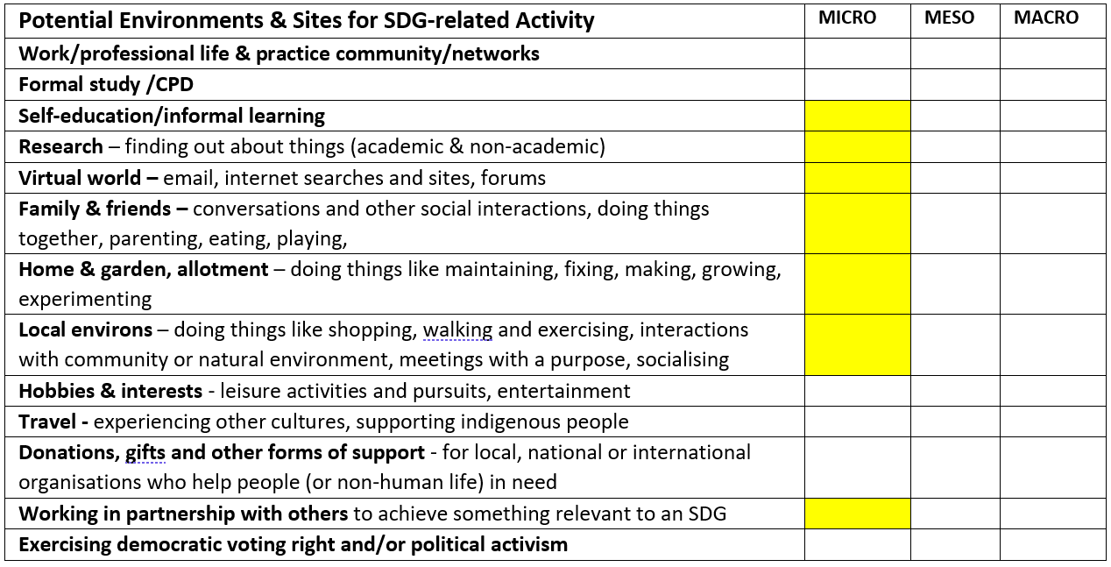
Mapping the Lifewide dimension of SDG-related activity
VIGNETTE 1 SDG #13. 15 & 3
VIGNETTE 2 SDG #15
VIGNETTE 2 SDG #7
VIGNETTE 3 SDG 4 & 17
VIGNETTE 4 SDG #7

Slide 11
CURATION & DISSEMINATION
Publication January 2022
Invitation to all participants
Article comprising
Introduction + Vignettes +
Personal perspectives on
the SDGs and what was learnt
Deadline December 22nd

