Slide 1



Developing student and graduate
competences for the 21st Century
DEVELOPING COMPETENT, CREATIVE PEOPLE FOR THE 21ST CENTURY: THE CONCEPT OF ECOLOGICAL COMPETENCE
NORMAN JACKSON
SLIDES & NARRATIVE http://www.lifewideeducation/sdu.html

Slide 2
CONCEPTS OF COMPETENCE
Competence ’….an organism's capacity to interact effectively with its environment’ White (1959)
Competence broad qualities exhibited by a person in relation to an acceptable standard of behaviour or performance [as they interact effectively with their environment]
Competencies - specific aspects of behaviour that attach to a task/activity in relation to a particular standard of performance
[as they interact effectively with their environment]
Hyland (1994)

Slide 3
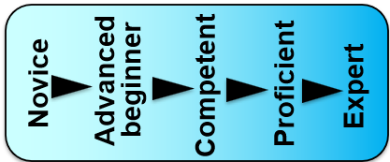
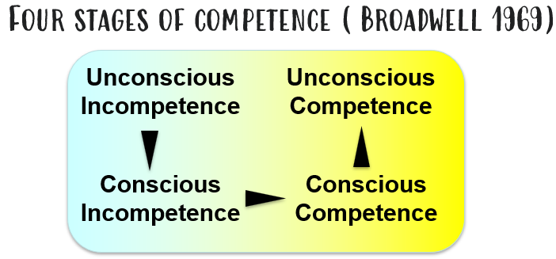
Novice to Expert Model (Dreyfus & Dreyfus 1980)
Knowledge
Standards of Work
Autonomy
Complexity
Perception of context

Slide 4
CONCEPT OF COMPETENCE FOR EDUCATION
Vitello, Greatorex & Shaw (2021)
“Competence is the ability to integrate and apply contextually-appropriate knowledge, skills and psychosocial factors (e.g., beliefs, attitudes, values and motivations) to consistently perform successfully within a specified domain”
my suggestion for a learning/growth orientation
with the will, confidence, self-regulatory habits and resilience to learn, develop and achieve, even in conditions of uncertainty,

Slide 5

“Epistemology of practice” Michael Eraut
PATTERN OF COGNITION-ACTION-LEARNING IN COMPETENT PRACTICE
Assessing situations
Deciding what, if any, action to take, both immediately and over a longer period
Pursuing an agreed course of action, performing actions – modifying actions as and when necessary
Metacognitive monitoring of oneself, people needing attention and the general progress of the case, problem, project or situation which feeds into our ongoing assessment, planning and action
Notes:
Michael Eraut’s model of the epistemology of practice in the professional environment based on many years of study of how professionals learn through their work is essentially a model of self-regulation.

Slide 6
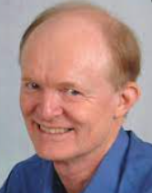
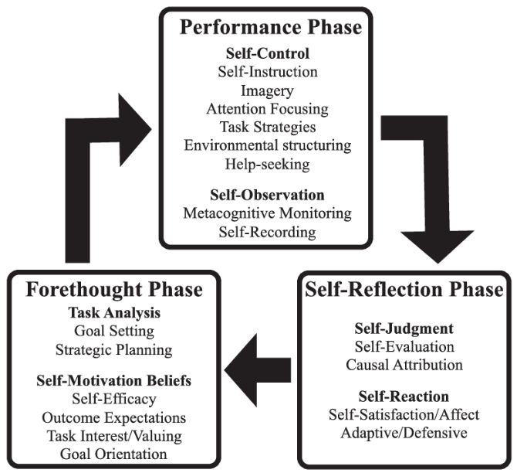
SELF-REGULATION - PSYCHOLOGY OF COMPETENT PRACTICE
Barry Zimmerman
Nokelainen, Kaisvuo & Pylväs (2017) Self-regulation & competence in WBL

Slide 7
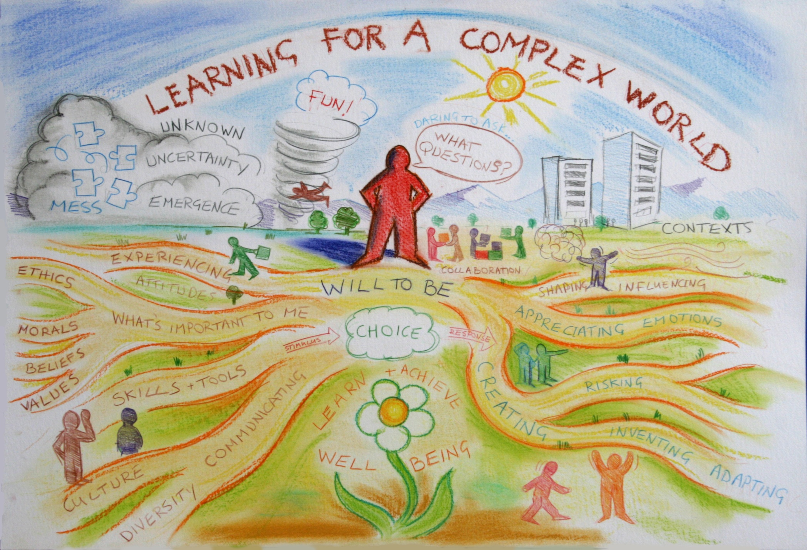
me 1978
A world in continuous formation
The core of the foundation for [future] readiness lies in developing a strong inner self that is resilient, reflective, and able to see, develop and value positive connections and relationships [with the world].
The Future of Learning, Redefining Readiness from the Inside Out Knowledge Works Forecast 4.0

Slide 8
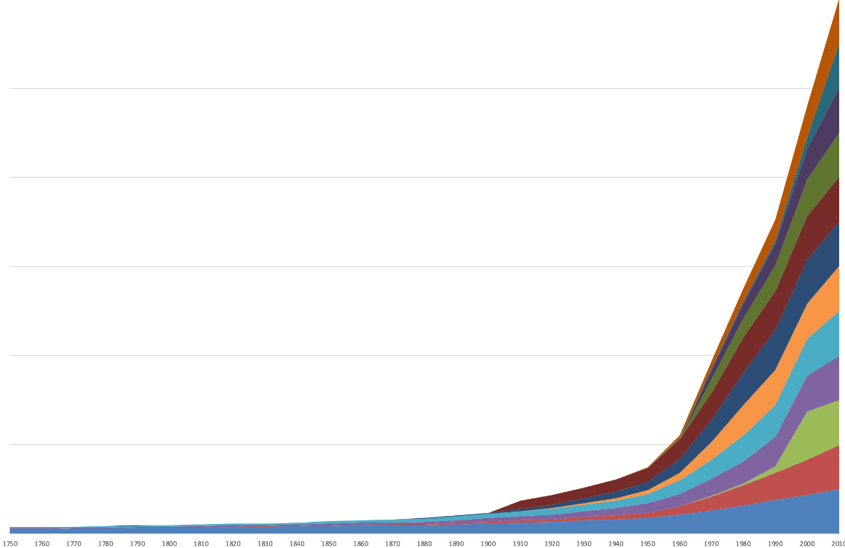
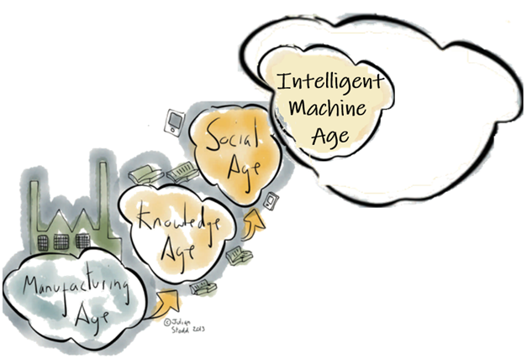
A WORLD IN
RAPID FORMATION
Science
industry
?
Hunter-gatherers
Agriculture
200,000
10,000
1550
1750
1950
2100
2020
?
The Great Acceleration
2100
2000
1950
1950

Slide 9
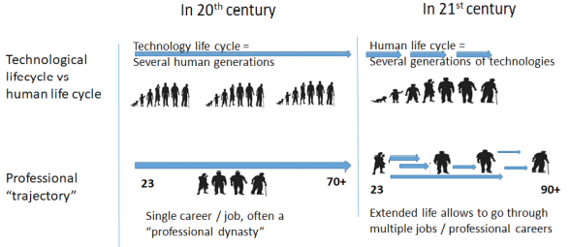


Sustaining self through a lifetime of work
Continuously learning and adapting
to new technologies and AI
Single or dual career pathways
Many roles & careers –
regenerating self many times
You can find work if you want it
Absence of work for many enables
people to contribute to society in
ways other than paid work
Human engagement with technology & work
Adapted from Luksha & Witold (2020)

Slide 10
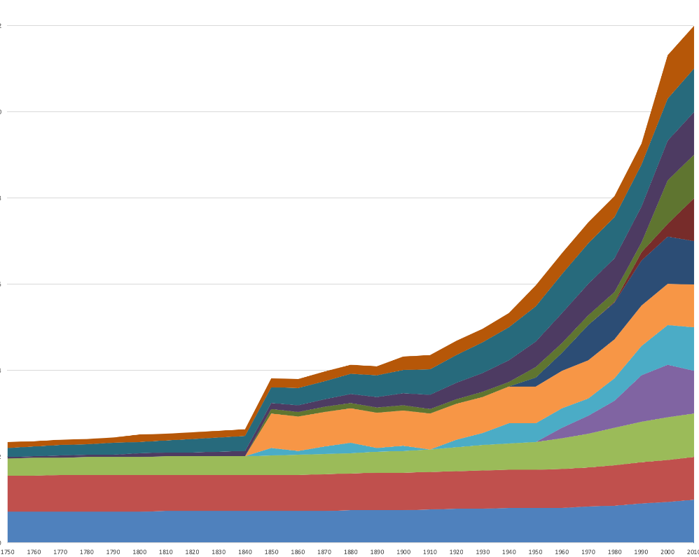
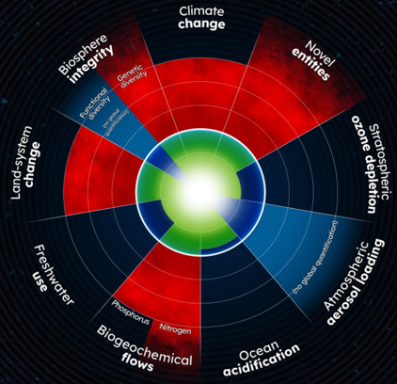
21ST CENTURY GLOBAL CHALLENGE
The Great Acceleration
the dramatic, continuous and roughly simultaneous surge in growth rate across a large range of measures of human activity
& impacts on Earth’s systems
1950
Rockström & Gaffney (2021) Breaking Boundaries: The Science of Our Planet.

Slide 11
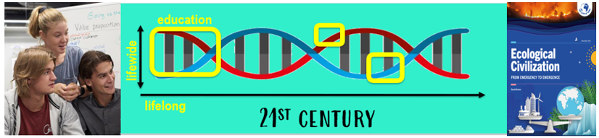
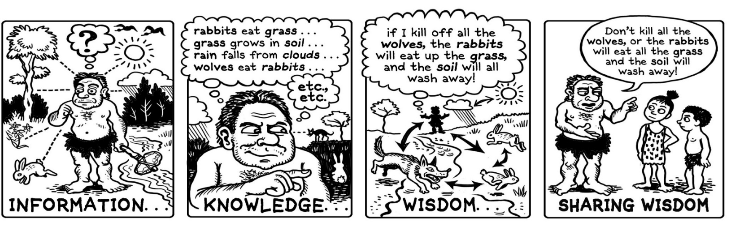
COMPETENCE TO MAKE THE TRANSITION TO A
WORLD FOUNDED ON ECOLOGICAL PRINCIPLES
Holistic notions of competence for 21st century must embrace
an ecological world view : mindful that we are ecological
beings, enacting life within and with an ecological world of relationships, connectivity and interdependency
“

Slide 12
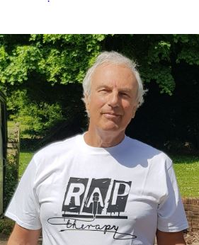
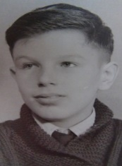
‘an organism's capacity to interact effectively with its environment’ White (1959)
Lifelong dimension of our formation
“retirement”
SCEPTrE
Uni Surrey
Lifewide Education
& Creative Academic
HE Academy
2ndmarriage
& family
parent /grandparent
parenthood
2010
2020
LTSN
2000
1990
QAA
HEQC
London
QA Uni Plymouth
Polytechnic
lecturer UK
bereavement
HMI
my wife’s illness
& death
parenthood
living away from home
parenthood
Field Geologist
Saudi Arabia
parenthood
Uni lecturer
Saudi Arabia
1970
geologist
in tin mine
1980
University
BSc geology
University
PhD geology
parenthood
School(s)
out of school activities
part time jobs
looking
after myself
marriage
living in Saudi
1960

Slide 13
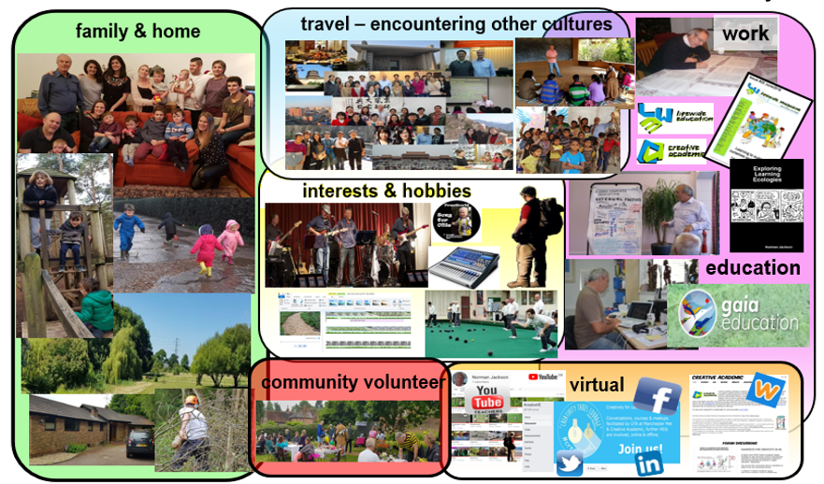
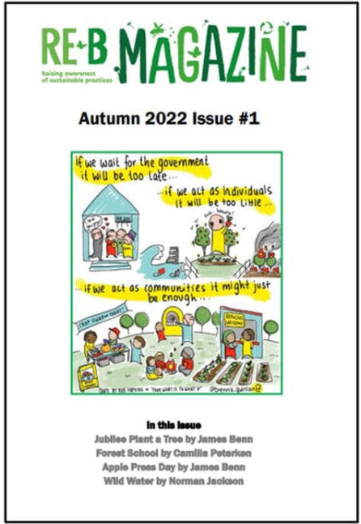
‘an organism's capacity to interact effectively with its environment’ White (1959)
Lifewide dimension of our formation

Slide 14
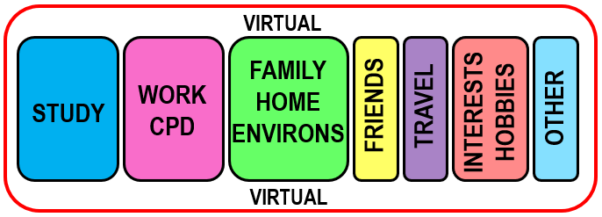
‘an organism's capacity to interact effectively with its environment’ White (1959)
LIFEWIDE SITES FOR LEARNING, DEVELOPING, FORMING
LIFELONG LEARNING Our Ontological Journey
Now, All, Personally Meaningful –necessary for present & foundation for the future
Formal / non-formal
Individual
Intended
Task-focused
Need
Directed
Planned
Extrinsic Motivation
Cognitive
Informal
Social
Unanticipated
Incidental
Interest
Self-directed
Emergent
Intrinsic Motivation
Emotional

Slide 15
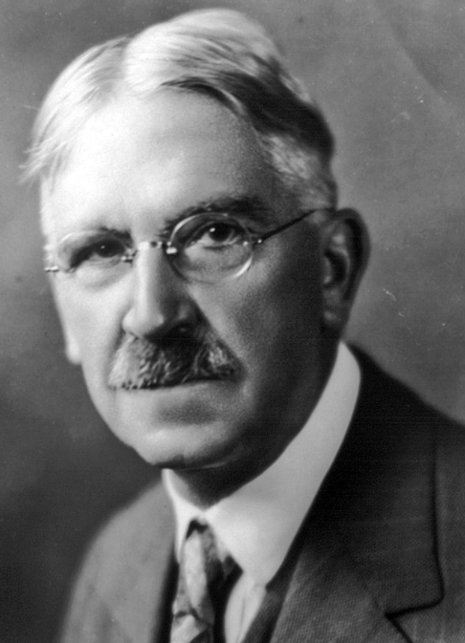

‘an organism's capacity to interact effectively
with its environment’ White (1959)
Dewey’s transactional model of experience involves people situated in and purposefully interacting with their environment, using resources that are accessible to them and modifying their environment and themselves in the process.
Person
PERCEIVE
situations &
create meaning
Lifewide Environments
our situations
Work/professional life/practice
Family, friends, community
Home /garden / environs Hobbies/interests/leisure activities
Virtual / technological
Travel / other cultures Formal / informal study
And more…………………….
UNDERGOING
before doing
D
O
I
N
G
PLAN
ACT/PERFORM
MONITOR EFFECTS
ADJUST ACTIONS
REFLECT
JUDGE EFFECTS
& CAUSES
UNDERGOING
while doing
UNDERGOING
after doing

Slide 16
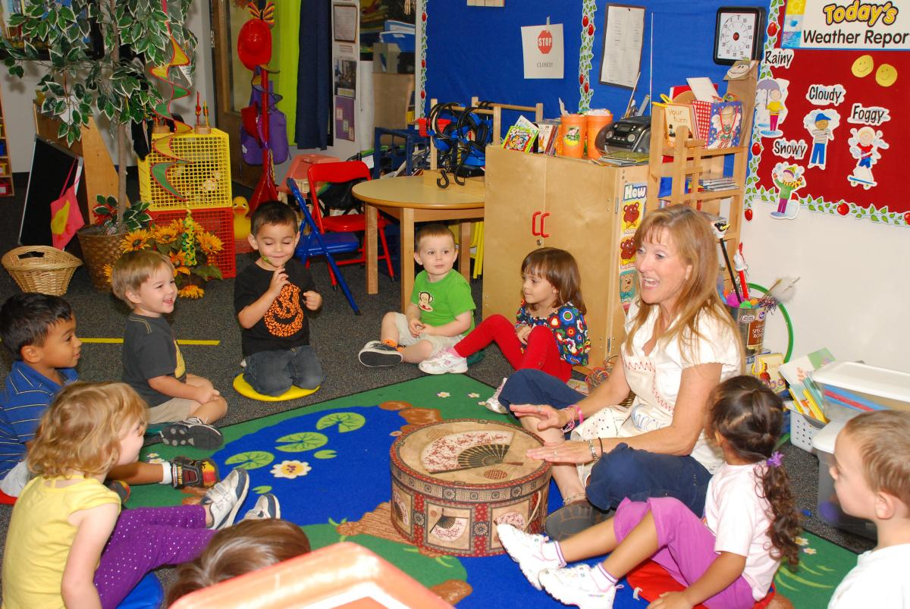
A teacher interacting effectively with her environment
UNDERGOING
before doing
TEACHER
ENVIRONMENT
UNDERGOING
while doing
PERCEIVE
DECIDE WHAT TO DO
ACT WITH SKILL & PURPOSE
MONITOR & ADJUST ACTIONS
UNDERGOING
after doing
REFLECT ON / LEARN FROM
WHOLE EXPERIENCE
LEARNING & OTHER
ACHIEVEMENTS EMERGE

Slide 17
‘an organism's capacity to interact effectively with its environment’ White (1959)
3 RESOURCES (knowledge & information flows, tools, materials, technologies)
teacher’s pedagogical knowledge, her knowledge of each child, the children’s own experiences, learning aids, posters/ pictures, musical instruments, writing materials, pupils’ work, internet
4 SPACES
Physical –
classroom
Social, Emotional
Intellectual, Liminal,
Creative
2 AFFORDANCE FOR LEARNING
In the teachers activities
The classroom environment
The children’s responses
an ecology of practice
PAST
Unfolding Present
FUTURE
5 PLACES
The classroom is the significant place for situational learning through the experience of doing
1 CONTEXT(S)
Moral purpose of education
Early years school ethos & culture
State educational policies
The teacher’s intentions/values
The teacher’s competence draws on her repertoire of competencies & skilfully weaves together the elements of her ecology. Through interaction and interpretation of information flows, she senses the effects of her actions on students’ learning and adjusts them : they both undergo.
6 RELATIONSHIPS
Teacher – children,
Between children
Teacher – parents, Parents- children
And relationships with subject, environment, materials, tools & activities
7 PROCESSES/ACTIVITIES/EXPERIENCES
Eg talking, discussing, listening, showing,
sharing stories, singing, dancing, reading,
painting and much more

Slide 18
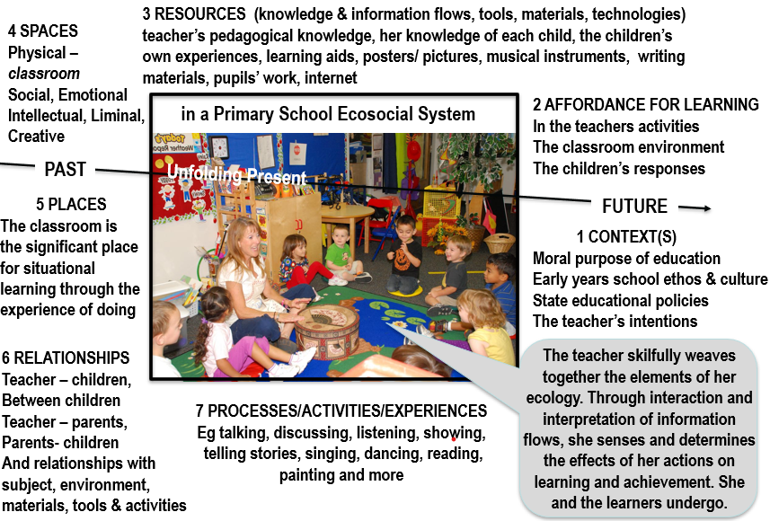
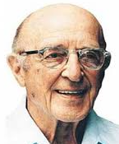

CREATIVITY AS
AN ECOLOGICAL,
EMERGENT,
TRANSFORMATIONAL
CONCEPT
'the emergence in action of a novel relational product growing out of the uniqueness of the individual on the one hand, and the materials, events, people, or circumstances of [their] life’
Carl Rogers (1960)
“Creativity is the process through which we take elements of ourselves and the world around us and transform them into something new.” Greg Bennick (2009).

Slide 19
ECOLOGY OF COMPETENT, CREATIVE PRACTICE HEURISTIC
3 RESOURCES
information, knowledge, people, tools, technologies
& other artefacts (anything that can be used)
2 AFFORDANCES
possibilities for thinking and action that can be perceived or imagined
4 SPACES
physical, social, virtual, intellectual, psychological, liminal, ontological
WHOLE PERSON
1 with their mind and body, needs, purposes, beliefs, values, motivations, knowledge, skills & more,
2 perceiving, sensing and creating meaning, feeling, imagining, relating to and interacting with their environment
3 making sense of situations, deciding what to do and weaving together aspects of themselves & things that matter
to accomplish their goals
ENVIRONMENT
1 CONTEXTS
situations, circumstances, culture, ourselves,
problems/opportunities
NEEDS
PAST
5 PLACES
significance of place for situational learning through the experience of doing
FUTURE
LEARNING,
CREATIVITY & OTHER
ACHIEVEMENTS
EMERGE
6 RELATIONSHIPS
with people, communities, places, ideas, objects, work, hobbies, problems,
natural world - anything!
7 PROCESSES/ACTIVITIES/EXPERIENCES
eg study, work, making, research, inquiry,
problem solving and much more
Notes:
Summary of the components of a learning ecology
Learning ecologies (Jackson 2013a:14) 'the process(es) we create in a particular context for a particular purpose that provides us with opportunities, relationships and resources for learning, development and achievement'.
This definition represents the integration and interdependence of the elements of learning and achievement which include the contexts and spaces we inhabit, including our history, relationships and resources, (the most important being knowledge and tools to aid thinking), and our will and capability to create a learning process or learning ecology for a particular purpose.
Such actions may be directed explicitly to learning or mastering something but more likely they will be primarily concerned with performing a task, resolving an issue, solving a problem, or making the most of a new opportunity.
Learning ecologies have temporal dimensions as well as spatial and contextual dimensions: they have the capability to connect different spaces and contexts existing simultaneously across a person's life-course, as well as different spaces and contexts existing in different time periods throughout their life-course.
HYPOTHESIS : ECOLOGIES FOR ACHIEVING OUR PURPOSES
ARE OUR VEHICLES FOR DISCOVERING & CREATING MEANING
Our beliefs shape what we value and what we value shape our beliefs
Our beliefs & values shape our purposes – purposes emerge from the circumstances of our life and what we value they give our life meaning
Purposes create intentions (will/desire/ambition) to act on purpose (to reinforce the meaning that is our life) eg the desire to make a positive contribution/to make a difference to create a better version of oneself and to create new value in the world we are attending
Intentions cause us to search our life/world (contexts) for affordance (perceptions of possibility for action – eg to make a difference)
Affordance enables us to formulate goals to drive specific actions and behaviours in the particular contexts and situations of our life/world
These actions and behaviours result in an ‘ecology for achieving our goals’. Our ecology is the way we interpret, relate to, connect and interact with our world of which we are a part not a separate entity. Our ecology involves relationships, activities, experiences, use of resources (knowledge/tools and other artefacts) through which we learn and develop in order to accomplish something we value and create new and deeper meanings in the process.
New meaning grows from the experiences and reflections on experience grown through our ecology when it is integrated with our previous understandings, values and beliefs. Our unfolding experiences contain things which are currently meaningful and also things that do not make sense to us. It is in striving to make sense or better sense of such things that new meaning grows in relation to all of the above. Its an ecological process.

Slide 20
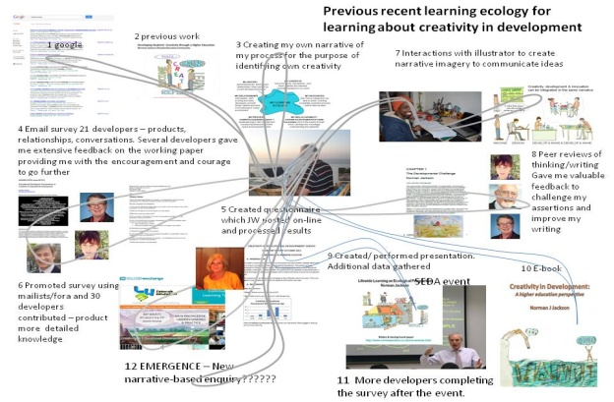

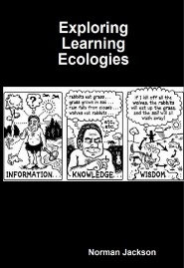
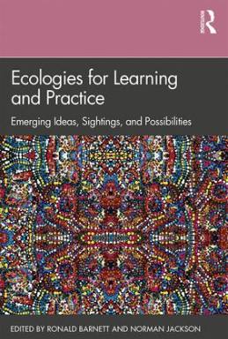
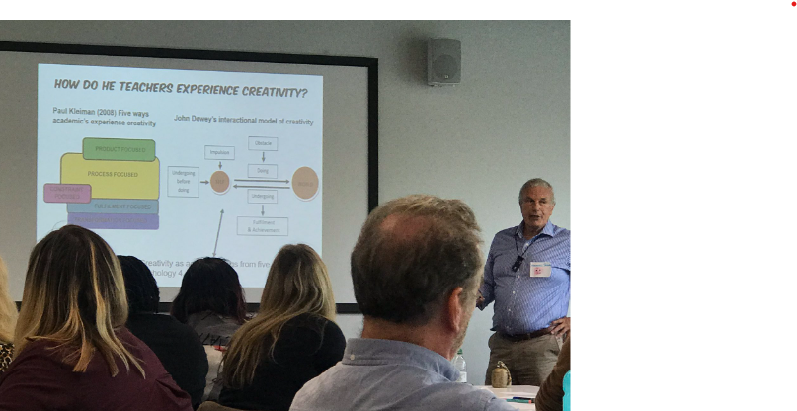
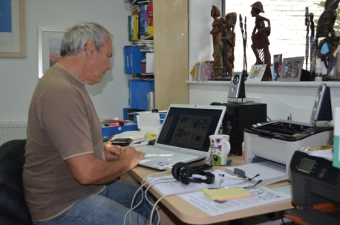

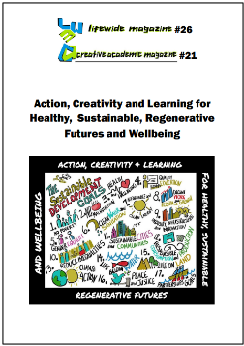

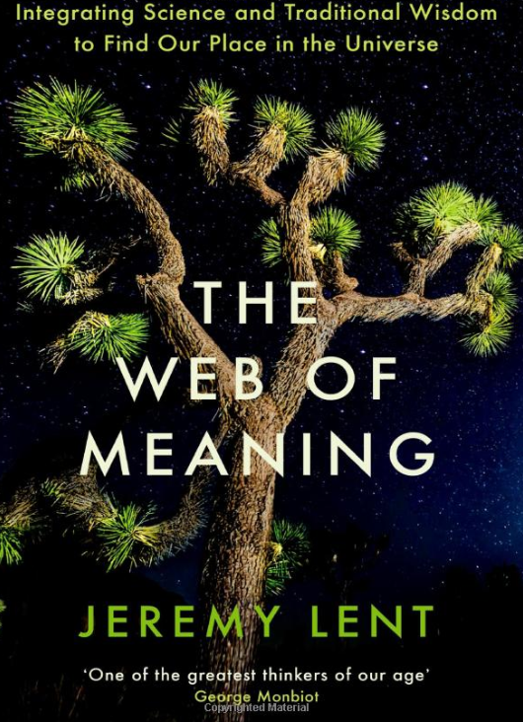
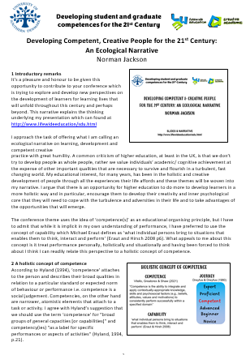
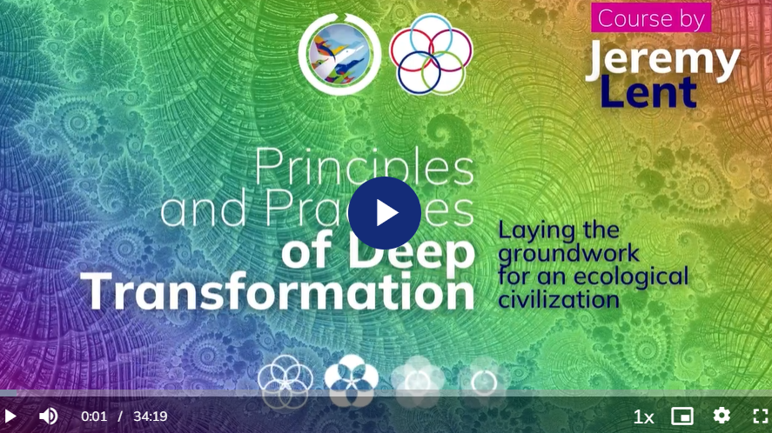
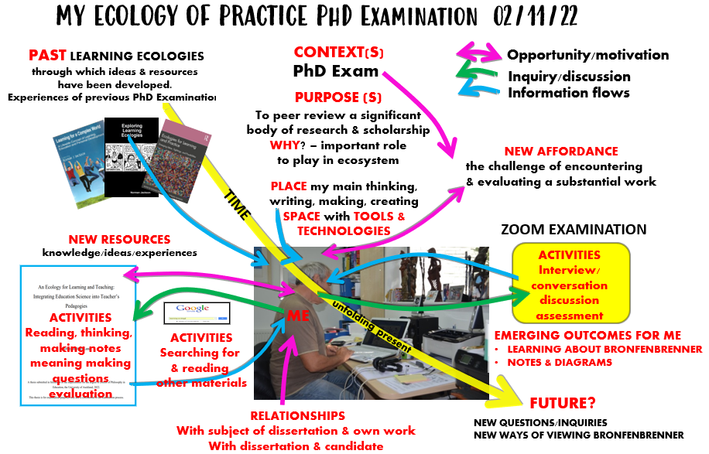
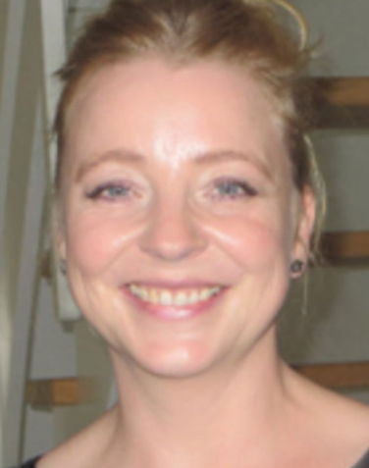

MY ECOLOGY OF PRACTICE TAL 2022
PAST LEARNING ECOLOGIES
through which ideas & resources
have been developed
CONTEXT(S)
Opportunity/motivation
SDU/TAL 2022/LWE
Inquiry/discussion
PURPOSE (S)
To share ideas in ways that are meaningful & useful and develop my own understanding of competence
Information flows
NEW AFFORDANCE
the challenge - conference
/opportunity in people &
resources I interact with
PLACE my main thinking, writing, making, creating
SPACE with TOOLS & TECHNOLOGIES +
home comforts
adapting existing RESOURCES
ACTIVITIES
performing
interacting
NEW RESOURCES/AFFORDANCE
ACTIVITIES
writing
thinking
discovering
knowledge/ideas/experiences
ME
EMERGING OUTCOMES
MY LEARNING
NARRATIVE PAPER
PPT SLIDES/TALK
unfolding present
ACTIVITIES
Action
Learning
ACTIVITIES
educational
FUTURE?
RELATIONSHIPS
conversations
with members of
TAL team
QUESTIONS/INQUIRIES
RELATIONSHIPS
COLLABORATIONS
?
ACTIVITIES
Work
Notes:
1) I drew on past learning ecologies and the resources I had developed through them including my learning about learning ecologies – learning ecology
2) I developed and posted the online survey based on previous surveys
3) I prepared a web page to enable my resources to be curated and shared with you
4) I shared my ideas through my presentation which included feedback on the results of the survey
5) I encouraged you to post your ideas and questions to #dmucreatives
While the ideas are not new to me the challenge has been in developing and presenting them for the particular context of your conference – it has made me think about what I know differently and also caused me to realise what I don’t know and that I should try to learn more. On this occasion my process has been mainly one of adaptation and recontextualisation but I feel it has become the starting point for a new trajectory of learning and a new ecology for learning.
PROMPTS FOR REFLECTING ON LEARNING WITHIN AN ECOLOGY
What purpose did your ecology fulfil? What were you trying to achieve?
What were the important contexts in which you were working? What new understandings of context did you have to develop in order to achieve?
What opportunities did you find or create for yourself that enabled you to achieve your goals?
What resources and tools did you draw upon to achieve your goals, and what new resources did you create?
What sort of physical, intellectual or emotional, spaces did you need or create in order to achieve your goals?
What processes/activities did you engage in order to achieve/perform?
What challenges did you have to overcome and what did you learn from engaging with these challenges?
What mistakes did you make that you learnt something useful from?
What important relationships did you form in order to achieve your goals? What did you learn through these relationships?

Slide 21
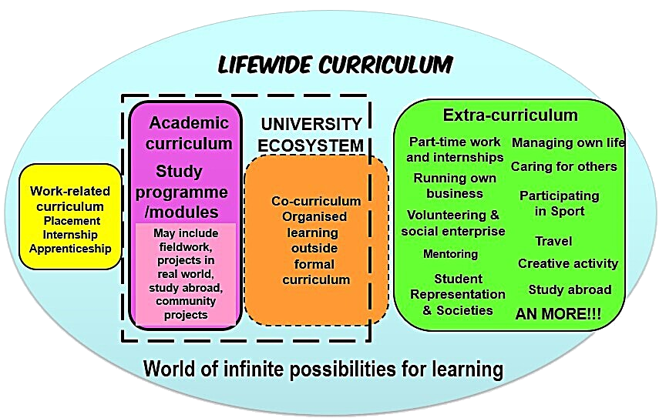
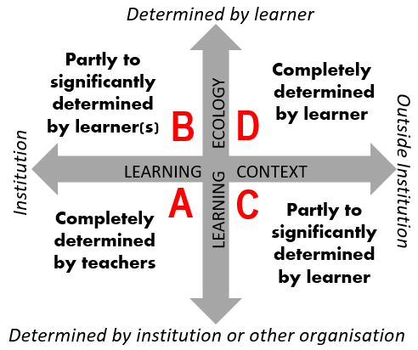
Learning & education for 21st century
proposition 1 :
The whole of a person’s
life is a resource for learning,
education, creativity & the
development of competence
CD
AB
BCD
CD
proposition 2 :
A key pedagogical task is to
enable learners to develop
their ecological competence
by enabling them to
create/co-create their
own ecologies of practice to
achieve their own goals

Slide 22

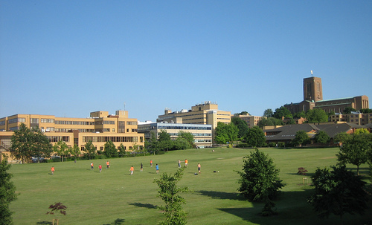

EXPERIMENT IN IMPLEMENTING THESE PROPOSITIONS
Undergraduate programmes
3Y academic (30%)
3Y integrated theory/practice (Health) (20%
4Y academic with professional training (50%)
SURREY LIFEWIDE LEARNING AWARD
valuing & recognising a more complete education

Slide 23
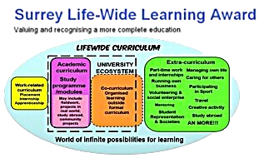
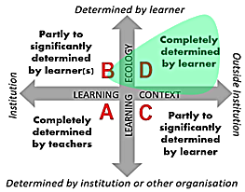
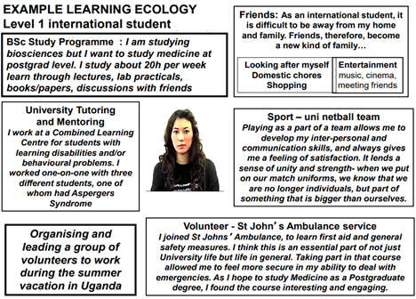
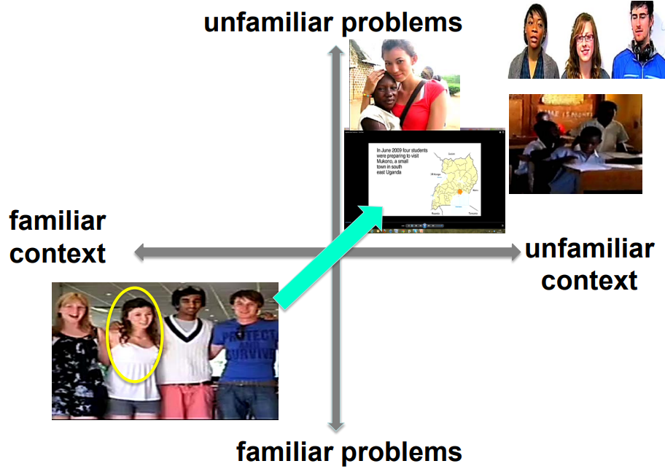
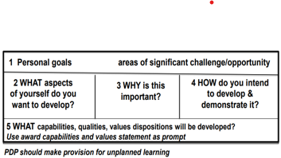
EXTRA-CURRICULUM – PERSONAL PROJECTS & CHALLENGES
1 Map
5 Reflect & Synthesize
4 Record
3 Act & React
2 Plan

Slide 24
SYNTHESIS ACCOUNT OF EXPERIENCES & DEVELOPMENT
Award Capabilities & Values Statement
1 Managing and evaluating my own development
2 Being able to deal with situations, solve problems, work with challenge and uncertainty and take advantage of opportunity
3 Being able to find out what you need to know to do what you need to do
4 Being creative and enterprising
5 Being an effective communicator
6 Being able to work with and lead others
7 Behaving ethically and with social responsibility
8 Other areas of personal development that are important to me
9 My will to be and become who I want to be
10 My values and the value I add to my enterprises
11 My growing confidence in my own ability

Slide 25
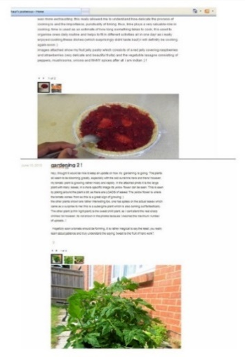
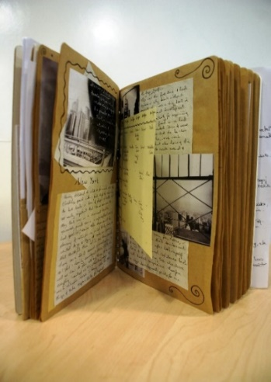
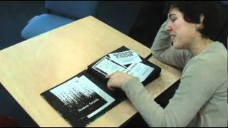
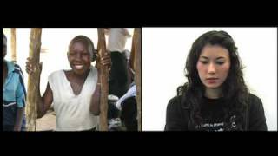

LIFE AS CURRICULUM – AUTHORING YOUR LIFE
Narratives of becoming within which ecologies for practice, learning and creativity reside
CATCHING STORIES
Shoe box
Blog
Scrapbook
E-portfolio
Video diary
Digital story
Movie
Slide show
Using life as curriculum enables students to reflect on their own ontological journey to reach self-awareness – the sense of authoring their life and how they construct themselves. Pharr Sharrah

Slide 26
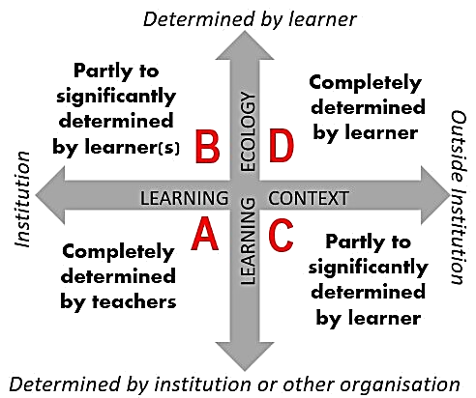
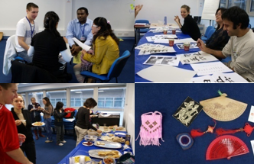
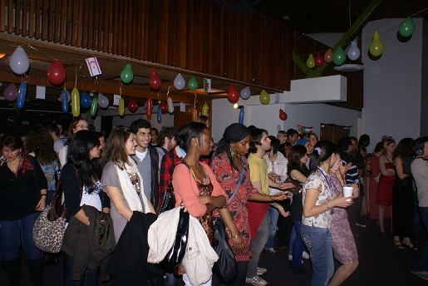
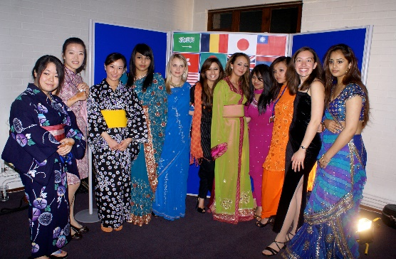
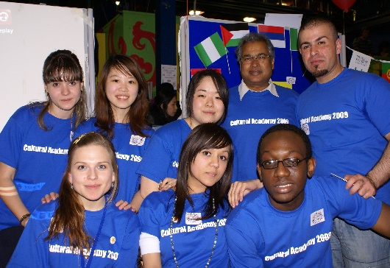

CO-CURRICULUM – ACTION- & CHALLENGE-BASED ENTERPRISES
Cultural enterprise – adding value to campus life
Cultural Academy (also business & social enterprise)
Challenges – organise multicultural ‘bash’ & conference
Individual, team & group discussion, action, inquiry – share cultural perspectives
Curate activity & learning - film/audio records
Reflect individually and collectively on how, what and why you learnt

Slide 27
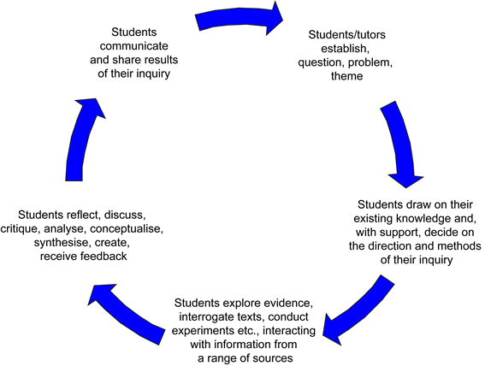

ACADEMIC CURRICULUM - INQUIRY-BASED LEARNING ECOLOGIES
COLLABORATIVE
INQUIRY-BASED
LEARNING ECOLOGY
Notes:
Evidence suggests that involving undergraduate students in Inquiry-Based Learning and research-type activities promotes the development of research ‘mindedness’, enhances learner motivation and engagement, develops graduate attributes and complex achievements, supports progression and retention, and prepares students for an uncertain and complex future (e.g. Brew 2006, Healey & Jenkins 2009; Levy et al. 2011). There is also evidence that this approach creates an environment conducive to collaborative learning, empowering students
‘The ecology of a university depends on a deep and abiding understanding that inquiry, investigation and discovery are at the heart of the enterprise, whether in funded research projects or in undergraduate classrooms or graduate apprenticeships. Everyone at a university should be a discoverer, a learner. That shared mission binds together all that happens on a campus Boyer (1999)
to engage in learner-led, peer-supported learning activities and to become co-creators of their own learning experience.Inquiry is the basis for all research and scholarship in the disciplines but it is also the key learning process in all knowledge development processes and is what sustains the ecology of the university (Boyer 1999).
Inquiry-Based Learning is an umbrella term to describe a range of active learning approaches that are driven by a process of enquiry. Khan and O'Rourke (2004) outline the main characteristics of IBL:
Engagement – with a complex problem or scenario – that is sufficiently open-ended to allow a variety of responses or solutions.
Students direct the lines of enquiry and the methods employed.
Figure 9 Representation of IBL process (Levy et al 2011)
The enquiry requires students to draw on existing knowledge and identify what else they need to know Tasks stimulate curiosity in the students, encouraging them to actively explore and discover new evidence to support the formulation of solutions.
Responsibility falls to the student for analysing and presenting that evidence in appropriate ways and in support of their own response to the problem.
IBL can be developed in any academic discipline. For example, in sciences it is fundamental to conducting
experiments, in technology for the testing and evaluation of materials and the building of prototypes, in natural sciences it is the basis of field investigations, in medicine PBL can form the basis of the whole curriculum, and IBL is the basis for individual and collaborative research in all disciplines. It can be used for whole programmes/modules or as discrete activities built into lectures, seminars, laboratory work, fieldwork or co-curricular activities. IBL may be undertaken as an individual project but it more typically a collaborative project in which learners work in small groups.
The EBL process can be represented as a cycle (shown in slide) involving: developing questions, making observations, negotiating and agreeing tasks, undertaking research to find out what information is available, recording and collating information, developing methods for surveys or experiments, developing instruments for data collection, collecting, analyzing, and interpreting data, developing tools and frameworks for analysis, discussing possible explanations and solutions, negotiating and agreeing the content of reports and making presentations that have to be defended, and then reflecting on the process of doing and learning.
Banchi and Bell (2008) identify four levels of inquiry through which learner autonomy and self-management increases (Table 2). Open inquiry activities are only successful if students are motivated by intrinsic interests and if they are equipped with the skills to conduct their own research study

Slide 28







From lectures to ecologies of practice
school of fashion Solent University
B
MANUFACTURE
(outsourced)
DESIGN
A
MODEL&
MARKET
B
REFLECT ON AND LEARN
FROM EXPERIENCE
C
C
SELL

Slide 29

Signature pedagogies &
signature learning experiences
Learning to create/co-create an ecology for competent creative practice
as an architect, engineer, surgeon, lawyer, geologist …….

Slide 30


A geologist's ecology of COMPETENT PRACTICE
information
KNOWLEDGE & PRODUCT
information
TOOLS
KNOWLEDGE & PRODUCT
KNOWLEDGE & PRODUCT
KNOWLEDGE & PRODUCT

Slide 31

A GEOLOGISTS ECOLOGY OF COMPETENT PRACTICE

Slide 32

LEARNING TO CREATE ECOLOGIES FOR COMPETENT CREATIVE PRACTICE

Slide 33
DEVELOPING COMPETENCE IN WORK SETTINGS
capability &
learning trajectories
Professor Michael Eraut

Slide 34

Dr Jenny Willis (SCEPTrE Fellow)
patterns of development revealed in learners narratives
8 categories
63 learning trajectories
Professor Michael Eraut

Slide 35





‘an organism's capacity to interact effectively with its environment’ White (1959)
Developing ecological competence through ecologies of practice
3 using/adapting existing competencies and developing new competencies through work
4 enhanced repertoire of competencies including ecological competence
Ecological competence
ASSESS
PLAN
ACT
MONITOR
ADJUST
REFLECT
EVALUATE
1 competencies
developed through life
2 competencies
developed through HE & life

Slide 36






THANK YOU
https://www.lifewideeducation.uk/
https://www.creativeacademic.uk/
https://www.learningecologies.uk/
http://www.lifewideaward.uk/

