Slide 1
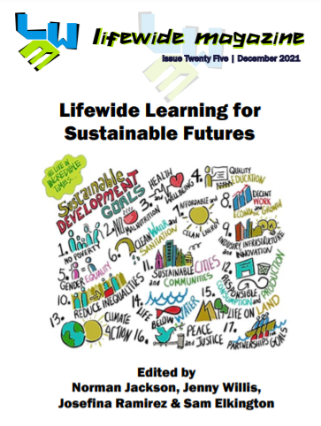
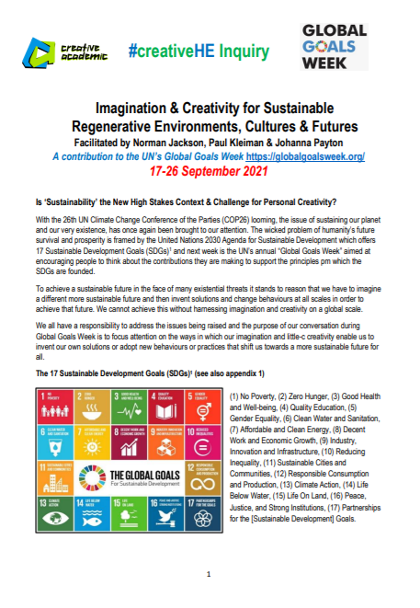
#creativeHE
Action, Creativity and Learning, for
Healthy, Sustainable, Regenerative Futures
Lifelong - lifewide learning is for oneself, for others and for the planet, it has a key role in driving sustainability.

Slide 2
Actions for a healthier, sustainable, regenerative world

Slide 3
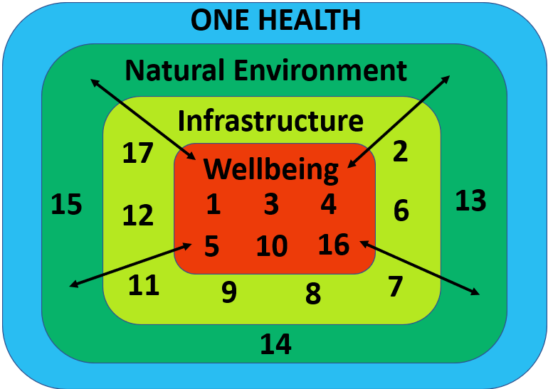
Queenan, K., Garnier, J., Nielsen, L., Buttigieg, S., De Meneghi, D., Holmberg, M., Zinsstag, J., Rüegg, S., Häsler, B., Kock, R. (2017). Roadmap to a One Health Agenda 2030. CAB Reviews Perspectives in Agriculture Veterinary Science Nutrition and Natural Resources. 12. 10.Available at: https://www.researchgate.net/publication/316841993_Roadmap_to_a_One_Health_Agenda_2030/download

Slide 4
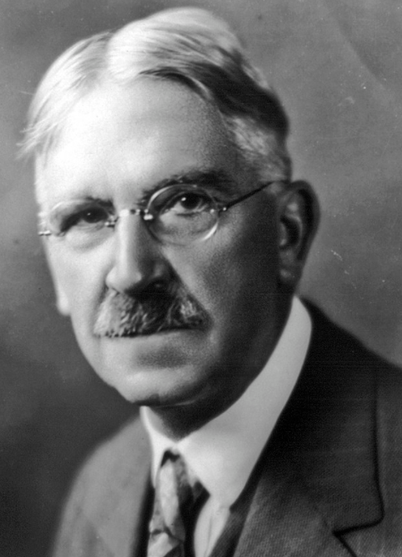
ACTION, LEARNING, creativity & ACHIEVEMENT
“When we experience something we act upon it, we do something; then we suffer or undergo the consequences. We do something to the thing and then it does something to us in return” John Dewey
UNDERGOING
before doing
Self
motivations
DOING
Lifewide Environments
Work/professional life/practice
Family, friends, community
Home /garden / environs Hobbies/interests/leisure activities
Virtual / technological
Travel / other cultures Formal / informal study
And more…………………….
D
O
I
N
G
IMAGINING
PLANNING
OBSERVING
ACTING/
PERFORMING
REFLECTING
SENSE MAKING
UNDERGOING
while doing
Achieving fully,
partially or not at all
UNDERGOING
after doing

Slide 5
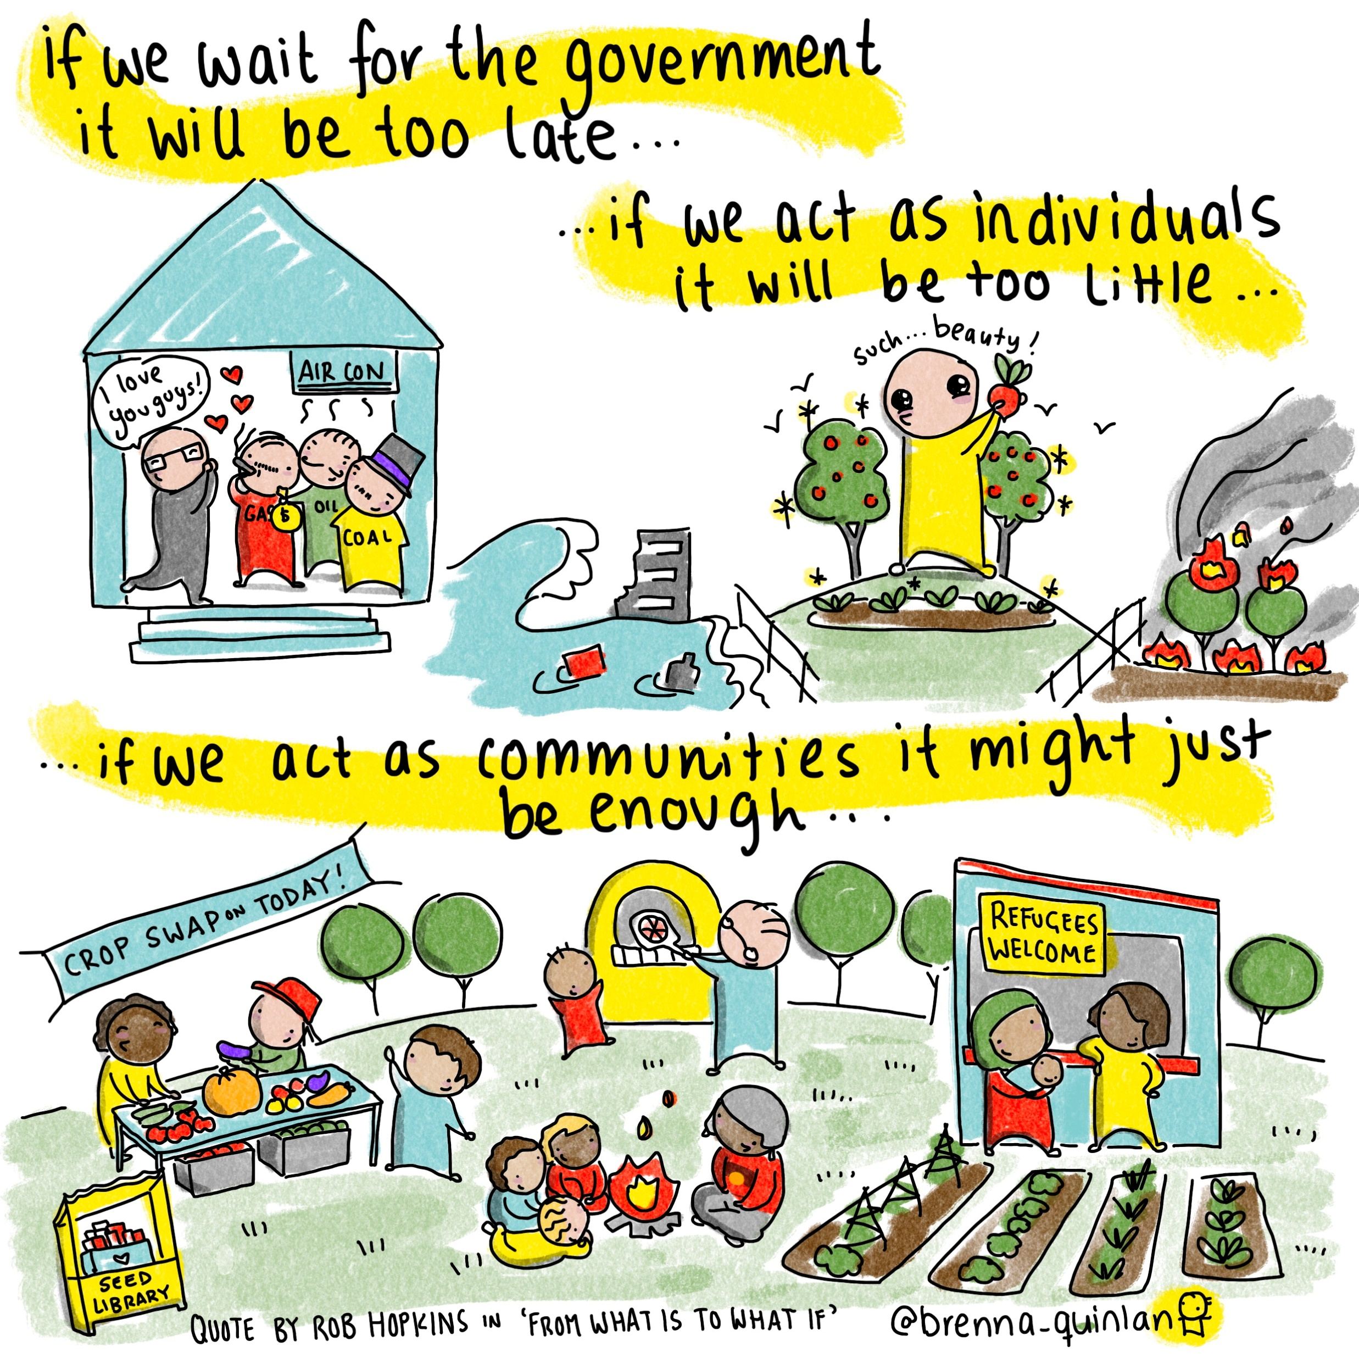
Spirit of Collective Action
illustration by Brenna Quinlan

Slide 6
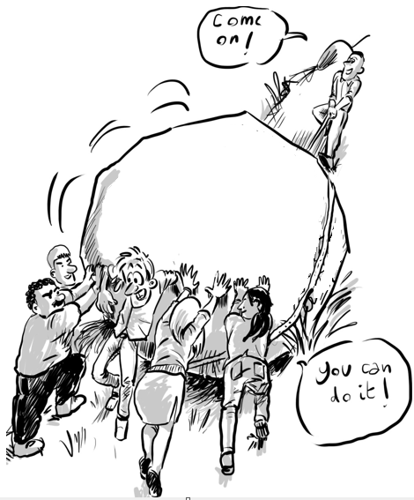
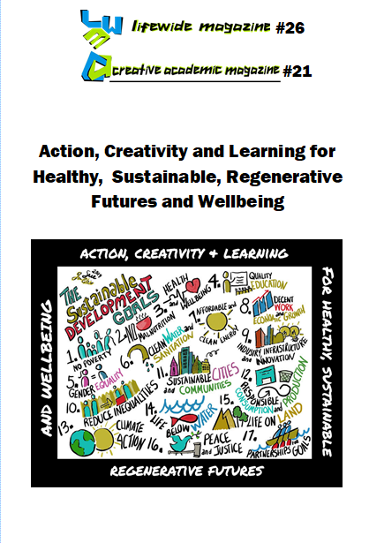
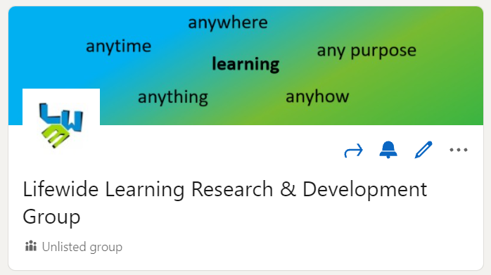
Collective action, learning & creativity
How can we make
this healthier?
Healthier
world
Our Stories
Share read discuss &learn together
Synthesize & share with others

Slide 7
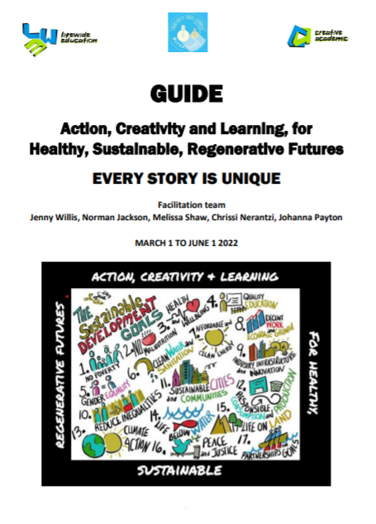
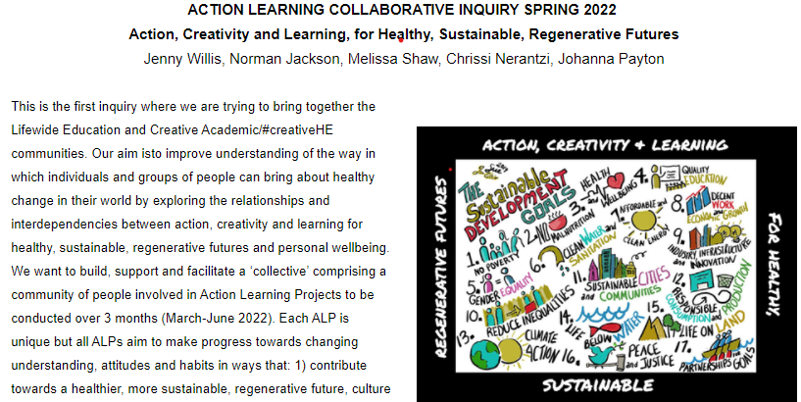
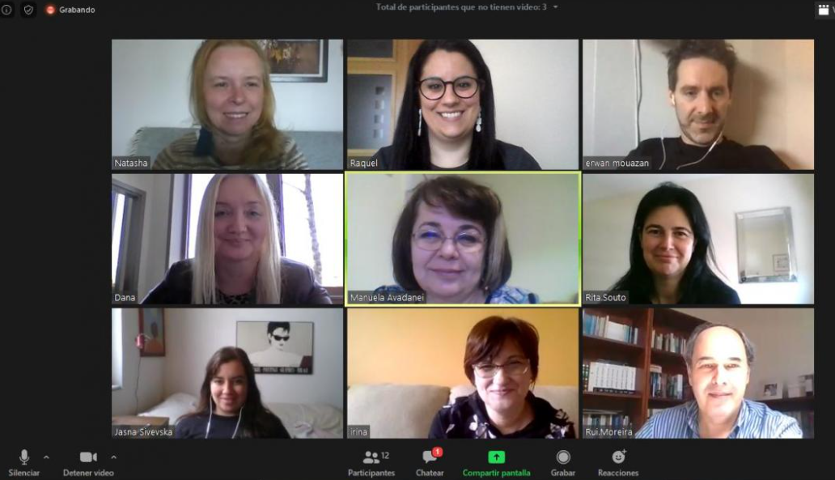
Infrastructure to support inquiry
Facilitation team
DISCUSSION FORUM
Monthly Zoom Meeting – chance to meet & share
https://www.lifewideeducation.uk/healthy-futures.html

Slide 8
Our social ecology for learning
Trust Respect Appreciation
Generosity & Curiosity
There is an expectation that members of the group will:
contribute stories about their experiences and what they
have learnt to the collaborative inquiry
be kind, generous, respectful and appreciative of the contributions
made by other members
help other members of the group gain deeper understandings or
different perspectives on their experiences through their comments and questions.

Slide 9
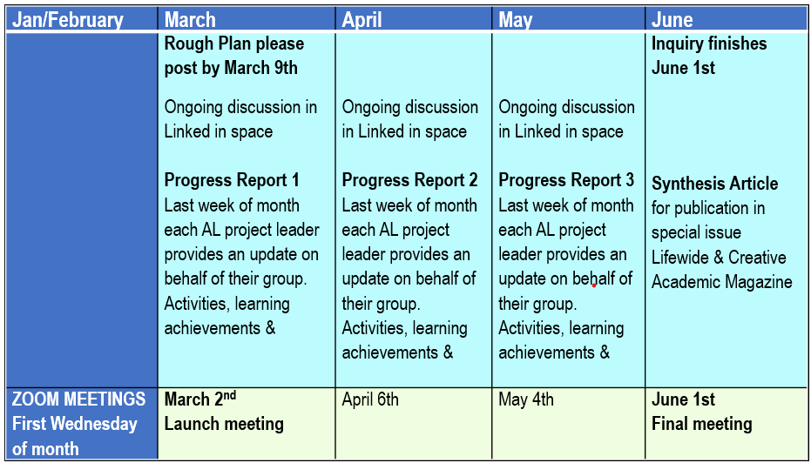
Action, Creativity and Learning, for
Healthy, Sustainable, Regenerative Futures
Lifewide Learning Research & Development Group –
Our social ecology for learning

Slide 10
Rough Plan – March 9th
Vision – What do you want to do? SDGs that are being addressed? How will the health of people, other living things, and /or the environment be improved?
Context – Why is this a concern or interest?
Actions –what sort of things will be done and who will be involved.
Please share in Linked In space by Wed March 9th
Plans will be collated into a single document and shared in the forum.

